Slide 1
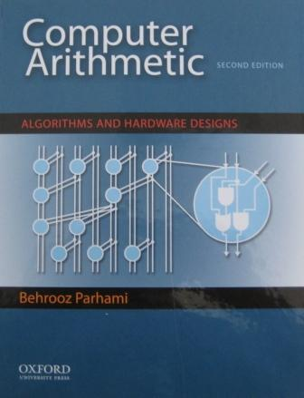
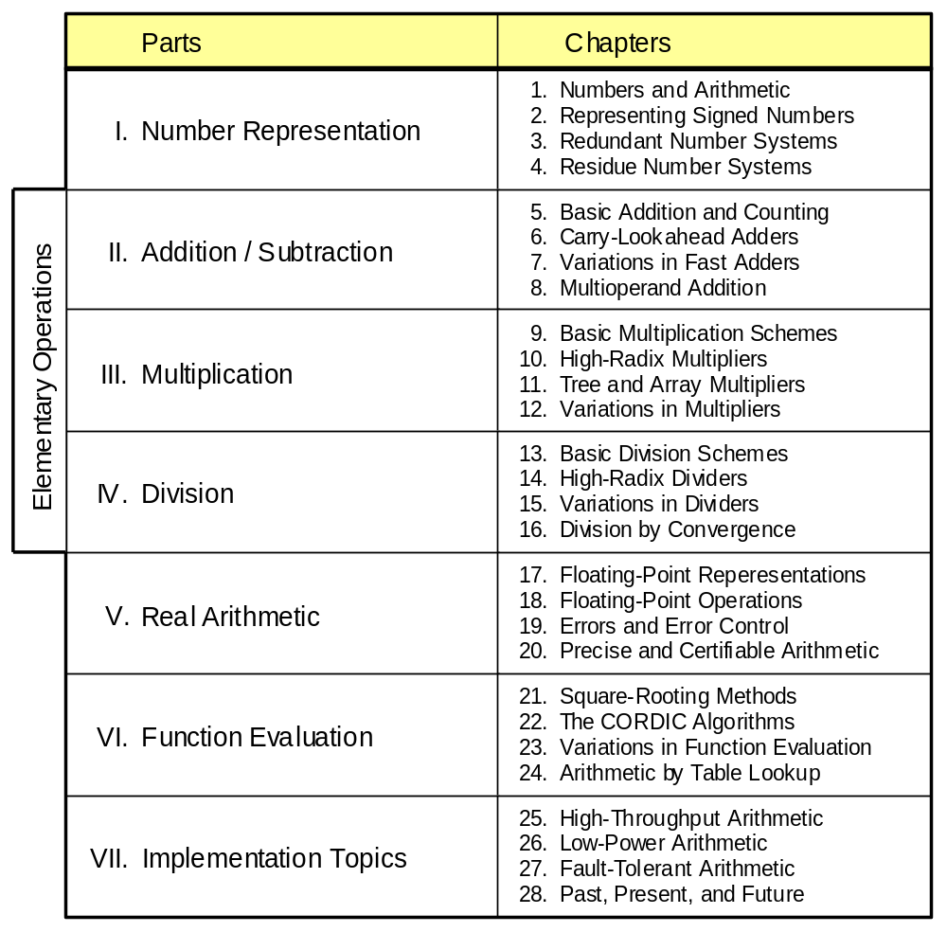
Part IV
Division
28. Reconfigurable Arithmetic
Appendix: Past, Present, and Future
May 2020
Computer Arithmetic, Division
Slide <number>

Slide 2
About This Presentation
This presentation is intended to support the use of the textbook Computer Arithmetic: Algorithms and Hardware Designs (Oxford U. Press, 2nd ed., 2010, ISBN 978-0-19-532848-6). It is updated regularly by the author as part of his teaching of the graduate course ECE 252B, Computer Arithmetic, at the University of California, Santa Barbara. Instructors can use these slides freely in classroom teaching and for other educational purposes. Unauthorized uses are strictly prohibited. © Behrooz Parhami
Edition | Released | Revised | Revised | Revised | Revised
First | Jan. 2000 | Sep. 2001 | Sep. 2003 | Oct. 2005 | May 2007
 |  | May 2008 | May 2009
Second | May 2010 | Apr. 2011 | May 2012 | May 2015 | May 2020
May 2020
Computer Arithmetic, Division
Slide <number>

Slide 3
IV Division
Review Division schemes and various speedup methods
  Hardest basic operation (fortunately, also the rarest)
  Division speedup methods: high-radix, array, . . .
  Combined multiplication / division hardware
  Digit-recurrence vs convergence division schemes
Topics in This Part
Chapter 13 Basic Division Schemes
Chapter 14 High-Radix Dividers
Chapter 15 Variations in Dividers
Chapter 16 Division by Convergence
May 2020
Computer Arithmetic, Division
Slide <number>

Slide 4
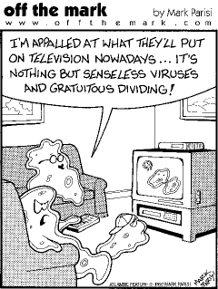
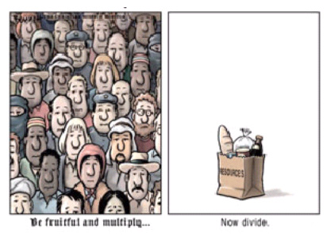
Be fruitful and multiply . . .
Now, divide.
May 2020
Computer Arithmetic, Division
Slide <number>

Slide 5
13 Basic Division Schemes
Chapter Goals
Study shift/subtract or bit-at-a-time dividers
and set the stage for faster methods and
variations to be covered in Chapters 14-16
Chapter Highlights
Shift/subtract divide vs shift/add multiply
Hardware, firmware, software algorithms
Dividing 2’s-complement numbers
The special case of a constant divisor
May 2020
Computer Arithmetic, Division
Slide <number>

Slide 6
Basic Division Schemes: Topics
Topics in This Chapter
13.1 Shift/Subtract Division Algorithms
13.2 Programmed Division
13.3 Restoring Hardware Dividers
13.4 Nonrestoring and Signed Division
13.5 Division by Constants
13.6 Radix-2 SRT Division
May 2020
Computer Arithmetic, Division
Slide <number>

Slide 7
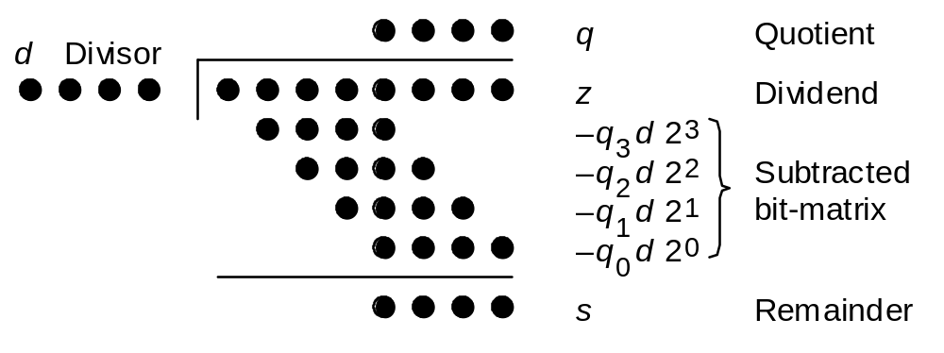
13.1 Shift/Subtract Division Algorithms
Notation for our discussion of division algorithms:
z Dividend z_{2k–1}z_{2k–2} . . . z₃z₂z₁z₀
d Divisor d_{k–1}d_{k–2} . . . d₁d₀
q Quotient q_{k–1}q_{k–2} . . . q₁q₀
s Remainder, z – (d × q) s_{k–1}s_{k–2} . . . s₁s₀
Initially, we assume unsigned operands
Fig. 13.1 Division of an 8-bit number by a 4-bit number in dot notation.
May 2020
Computer Arithmetic, Division
Slide <number>

Slide 8
Division versus Multiplication
Division is more complex than multiplication:
Need for quotient digit selection or estimation
Overflow possibility: the high-order k bits of z
must be strictly less than d; this overflow check
also detects the divide-by-zero condition.
Pentium III latencies
Instruction Latency Cycles/Issue
Load / Store 3 1
Integer Multiply 4 1
Integer Divide 36 36
Double/Single FP Multiply 5 2
Double/Single FP Add 3 1
Double/Single FP Divide 38 38
The ratios haven’t changed much in
later Pentiums, Atom, or AMD products*
*Source: T. Granlund, “Instruction Latencies and Throughput for AMD and Intel x86 Processors,” Feb. 2012
May 2020
Computer Arithmetic, Division
Slide <number>

Slide 9
Division Recurrence
2z
0
2^{k} d
Fig. 13.1
k bits
k bits
Division with left shifts
s^{(j)} = 2s^{(j–1)} – q_{k–j} (2^{k} d) with s⁽⁰⁾ = z and
|–shift–| s^{(k)} = 2^{k}s
|––– subtract –––|
(There is no corresponding right-shift algorithm)
Integer division is characterized by z = d × q + s
2^{–2k}z = (2^{–k}d) × (2^{–k}q) + 2^{–2k}s
z_{frac} = d_{frac} × q_{frac} + 2^{–k} s_{frac}
Divide fractions like integers; adjust the remainder
No-overflow
condition for
fractions is:
z_{frac} < d_{frac}
May 2020
Computer Arithmetic, Division
Slide <number>

Slide 10
Examples of Basic Division
Decimal
Integer division Fractional division
====================== =====================
z 0 1 1 1 0 1 0 1 z_{frac} . 0 1 1 1 0 1 0 1
2⁴d 1 0 1 0 d_{frac} . 1 0 1 0
====================== =====================
s⁽⁰⁾ 0 1 1 1 0 1 0 1 s⁽⁰⁾ . 0 1 1 1 0 1 0 1
2s⁽⁰⁾ 0 1 1 1 0 1 0 1 2s⁽⁰⁾ 0 . 1 1 1 0 1 0 1
–q₃ 2⁴d 1 0 1 0 {q₃ = 1} –q_{–1}d . 1 0 1 0 {q_{–1}=1}
––––––––––––––––––––––– ––––––––––––––––––––––
s⁽¹⁾ 0 1 0 0 1 0 1 s⁽¹⁾ . 0 1 0 0 1 0 1
2s⁽¹⁾ 0 1 0 0 1 0 1 2s⁽¹⁾ 0 . 1 0 0 1 0 1
–q₂ 2⁴d 0 0 0 0 {q₂ = 0} –q_{–2}d . 0 0 0 0 {q_{–2}=0}
––––––––––––––––––––––– ––––––––––––––––––––––
s⁽²⁾ 1 0 0 1 0 1 s⁽²⁾ . 1 0 0 1 0 1
2s⁽²⁾ 1 0 0 1 0 1 2s⁽²⁾ 1 . 0 0 1 0 1
–q₁ 2⁴d 1 0 1 0 {q₁ = 1} –q_{–3}d . 1 0 1 0 {q_{–3}=1}
––––––––––––––––––––––– ––––––––––––––––––––––
s⁽³⁾ 1 0 0 0 1 s⁽³⁾ . 1 0 0 0 1
2s⁽³⁾ 1 0 0 0 1 2s⁽³⁾ 1 . 0 0 0 1
–q₀ 2⁴d 1 0 1 0 {q₀ = 1} –q_{–4}d . 1 0 1 0 {q_{–4}=1}
––––––––––––––––––––––– ––––––––––––––––––––––
s⁽⁴⁾ 0 1 1 1 s⁽⁴⁾ . 0 1 1 1
s 0 1 1 1 s_{frac} 0 . 0 0 0 0 0 1 1 1
q 1 0 1 1 q_{frac} . 1 0 1 1
====================== =====================
Fig. 13.2 Examples of sequential division with integer and fractional operands.
117
10
7
11
May 2020
Computer Arithmetic, Division
Slide <number>

Slide 11
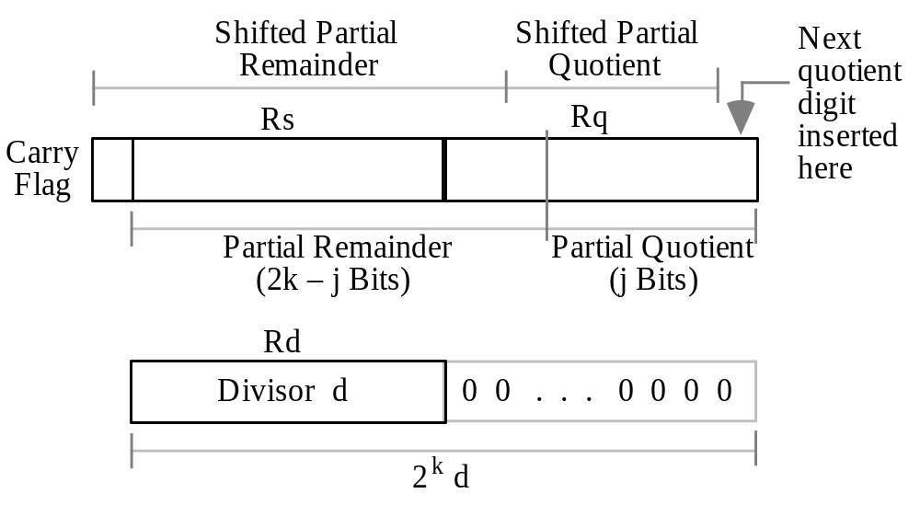
13.2 Programmed Division
Fig. 13.3 Register usage for programmed division.
May 2020
Computer Arithmetic, Division
Slide <number>

Slide 12
Assembly Language Program for Division
{Using left shifts, divide unsigned 2k-bit dividend,
z_high|z_low, storing the k-bit quotient and remainder.
Registers: R0 holds 0 Rc for counter
Rd for divisor Rs for z_high & remainder
Rq for z_low & quotient}
{Load operands into registers Rd, Rs, and Rq}
div: load Rd with divisor
load Rs with z_high
load Rq with z_low
{Check for exceptions}
branch d_by_0 if Rd = R0
branch d_ovfl if Rs > Rd
{Initialize counter}
load k into Rc
{Begin division loop}
d_loop: shift Rq left 1 {zero to LSB, MSB to carry}
rotate Rs left 1 {carry to LSB, MSB to carry}
skip if carry = 1
branch no_sub if Rs < Rd
sub Rd from Rs
incr Rq {set quotient digit to 1}
no_sub: decr Rc {decrement counter by 1}
branch d_loop if Rc ≠ 0
{Store the quotient and remainder}
store Rq into quotient
store Rs into remainder
d_by_0: ...
d_ovfl: ...
d_done: ...
Fig. 13.3 Register usage for programmed division.
Fig. 13.4 Programmed division using left shifts.
May 2020
Computer Arithmetic, Division
Slide <number>

Slide 13
Time Complexity of Programmed Division
Assume k-bit words
k iterations of the main loop
6-8 instructions per iteration, depending on the quotient bit
Thus, 6k + 3 to 8k + 3 machine instructions,
ignoring operand loads and result store
k = 32 implies 220⁺ instructions on average
This is too slow for many modern applications!
Microprogrammed division would be somewhat better
May 2020
Computer Arithmetic, Division
Slide <number>

Slide 14
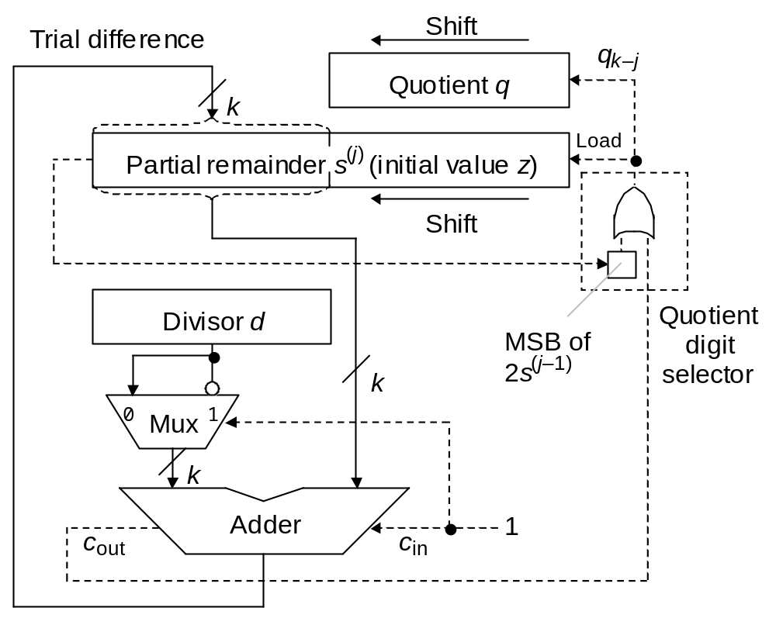
13.3 Restoring Hardware Dividers
2z
0
2^{k} d
k bits
k bits
In 2’s-complement arithmetic, adding
a negative value
to a positive value produces c_{out} = 1 if the result is positive
Fig. 13.5 Shift/subtract sequential restoring divider.
May 2020
Computer Arithmetic, Division
Slide <number>

Slide 15
Example of Restoring Unsigned Division
=======================
z 0 1 1 1 0 1 0 1
2⁴d 0 1 0 1 0
–2⁴d 1 0 1 1 0
=======================
s⁽⁰⁾ 0 0 1 1 1 0 1 0 1
2s⁽⁰⁾ 0 1 1 1 0 1 0 1
+(–2⁴d) 1 0 1 1 0
––––––––––––––––––––––––
s⁽¹⁾ 0 0 1 0 0 1 0 1 Positive, so set q₃ = 1
2s⁽¹⁾ 0 1 0 0 1 0 1
+(–2⁴d) 1 0 1 1 0
––––––––––––––––––––––––
s⁽²⁾ 1 1 1 1 1 0 1 Negative, so set q₂ = 0
s⁽²⁾=2s⁽¹⁾ 0 1 0 0 1 0 1 and restore
2s⁽²⁾ 1 0 0 1 0 1
+(–2⁴d) 1 0 1 1 0
––––––––––––––––––––––––
s⁽³⁾ 0 1 0 0 0 1 Positive, so set q₁ = 1
2s⁽³⁾ 1 0 0 0 1
+(–2⁴d) 1 0 1 1 0
––––––––––––––––––––––––
s⁽⁴⁾ 0 0 1 1 1 Positive, so set q₀ = 1
s 0 1 1 1
q 1 0 1 1 =======================
No overflow, because
(0111)_{two} < (1010)_{two}
Fig. 13.6 Example of restoring unsigned division.
May 2020
Computer Arithmetic, Division
Slide <number>

Slide 16
Indirect Signed Division
In division with signed operands, q and s are defined by
z = d × q + s sign(s) = sign(z) |s | < |d |
Examples of division with signed operands
z = 5 d = 3 ⇒ q = 1 s = 2
z = 5 d = –3 ⇒ q = –1 s = 2
z = –5 d = 3 ⇒ q = –1 s = –2
z = –5 d = –3 ⇒ q = 1 s = –2
Magnitudes of q and s are unaffected by input signs
Signs of q and s are derivable from signs of z and d
(not q = –2, s = –1)
Will discuss direct signed division later
May 2020
Computer Arithmetic, Division
Slide <number>

Slide 17
13.4 Nonrestoring and Signed Division
The cycle time in restoring division must accommodate:
Shifting the registers
Allowing signals to propagate through the adder
Determining and storing the next quotient digit
Storing the trial difference, if required
Later events depend on earlier ones in the same cycle, causing a lengthening of the clock cycle
Nonrestoring division to the rescue!
Assume q_{k–j} = 1 and subtract
Store the result as the new PR
(the partial remainder can
become incorrect, hence
the name “nonrestoring”)
May 2020
Computer Arithmetic, Division
Slide <number>

Slide 18
Justification for Nonrestoring Division
Why it is acceptable to store an incorrect value in the
partial-remainder register?
Shifted partial remainder at start of the cycle is u
Suppose subtraction yields the negative result u – 2^{k}d
Option 1: Restore the partial remainder to correct value u,
shift left, and subtract to get 2u – 2^{k}d
Option 2: Keep the incorrect partial remainder u – 2^{k}d,
shift left, and add to get 2(u – 2^{k}d) + 2^{k}d = 2u – 2^{k}d
May 2020
Computer Arithmetic, Division
Slide <number>

Slide 19
Example of Nonrestoring Unsigned Division
Decimal
=======================
z 0 1 1 1 0 1 0 1
2⁴d 0 1 0 1 0
–2⁴d 1 0 1 1 0
=======================
s⁽⁰⁾ 0 0 1 1 1 0 1 0 1
2s⁽⁰⁾ 0 1 1 1 0 1 0 1 Positive,
+(–2⁴d) 1 0 1 1 0 so subtract
––––––––––––––––––––––––
s⁽¹⁾ 0 0 1 0 0 1 0 1
2s⁽¹⁾ 0 1 0 0 1 0 1 Positive, so set q₃ = 1
+(–2⁴d) 1 0 1 1 0 and subtract
––––––––––––––––––––––––
s⁽²⁾ 1 1 1 1 1 0 1
2s⁽²⁾ 1 1 1 1 0 1 Negative, so set q₂ = 0
+2⁴d 0 1 0 1 0 and add
––––––––––––––––––––––––
s⁽³⁾ 0 1 0 0 0 1
2s⁽³⁾ 1 0 0 0 1 Positive, so set q₁ = 1
+(–2⁴d) 1 0 1 1 0 and subtract
––––––––––––––––––––––––
s⁽⁴⁾ 0 0 1 1 1 Positive, so set q₀ = 1
s 0 1 1 1
q 1 0 1 1 =======================
117
10 × 16
No overflow: (0111)_{two} < (1010)_{two}
7
11
Fig. 13.7 Example of nonrestoring unsigned division.
May 2020
Computer Arithmetic, Division
Slide <number>

Slide 20
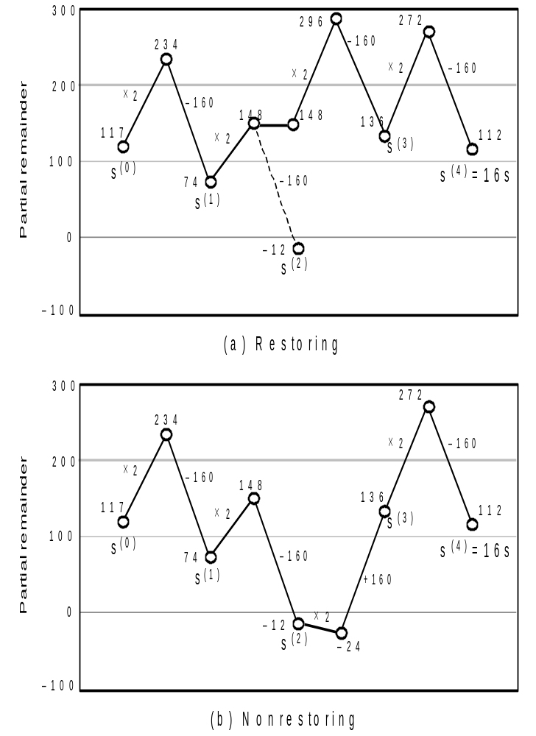
Graphical Depiction of Nonrestoring Division
Example
(0 1 1 1 0 1 0 1)_{two} / (1 0 1 0)_{two}
(117)_{ten} / (10)_{ten}
Fig. 13.8 Partial remainder variations for restoring and nonrestoring division.
May 2020
Computer Arithmetic, Division
Slide <number>

Slide 21
Convergence of the
Partial Quotient to q
Partial quotient
1111
1110
1101
Example
(0 1 1 1 0 1 0 1)_{two} / (1 0 1 0)_{two}
(117)_{ten}/(10)_{ten} = (11)_{ten} = (1011)_{two}
q⁽²⁾
1100
Nonrestoring
q⁽⁴⁾
1011
q
1010
q⁽³⁾
1001
Restoring
1000
q⁽¹⁾
q⁽²⁾
In restoring division, the partial quotient converges to q from below
0111
0110
0101
0100
In nonrestoring division, the partial quotient may overshoot q, but converges to it after some oscillations
0011
0010
0001
q⁽⁰⁾
Iteration
0000
0
1
2
3
4
May 2020
Computer Arithmetic, Division
Slide <number>

Slide 22
Nonrestoring Division with Signed Operands
Restoring division
q_{k–j} = 0 means no subtraction (or subtraction of 0)
q_{k–j} = 1 means subtraction of d
Nonrestoring division
We always subtract or add
It is as if quotient digits are selected from the set {1, −1}:
1 corresponds to subtraction −1 corresponds to addition
Our goal is to end up with a remainder that matches the sign
of the dividend
This idea of trying to match the sign of s with the sign of z, leads to a direct signed division algorithm
if sign(s) = sign(d) then q_{k–j} = 1 else q_{k–j} = −1
Example: q = . . . 0 0 0 1 . . .
. . . 1 ⁻1 ⁻1 ⁻1 . . .
May 2020
Computer Arithmetic, Division
Slide <number>

Slide 23
Quotient Conversion and Final Correction
×2
−d
Partial remainder variation and selected quotient digits during nonrestoring division with d > 0
d
0
−d
×2
−d
×2
+d
−d
+d
+d
×2
z
×2
Quotient with digits ⁻1 and 1
⁻1 1 ⁻1 ⁻1 1 1
Replace ⁻1s with 0s
0 1 0 0 1 1
Shift left, complement MSB,
and set LSB to 1 to get the 2’s-complement quotient
1 1 0 0 1 1 1
Check: −32 + 16 – 8 – 4 + 2 + 1 = −25 = −64 + 32 + 4 + 2 + 1
1 1 0 1 0 0 0
Final correction step if sign(s) ≠ sign(z):
Add d to, or subtract d from, s; subtract 1 from, or add 1 to, q
May 2020
Computer Arithmetic, Division
Slide <number>

Slide 24
Example of Nonrestoring Signed Division
========================
z 0 0 1 0 0 0 0 1
2⁴d 1 1 0 0 1
–2⁴d 0 0 1 1 1
========================
s⁽⁰⁾ 0 0 0 1 0 0 0 0 1
2s⁽⁰⁾ 0 0 1 0 0 0 0 1 sign(s⁽⁰⁾) ≠ sign(d),
+2⁴d 1 1 0 0 1 so set q₃ = ⁻1 and add
––––––––––––––––––––––––
s⁽¹⁾ 1 1 1 0 1 0 0 1
2s⁽¹⁾ 1 1 0 1 0 0 1 sign(s⁽¹⁾) = sign(d),
+(–2⁴d) 0 0 1 1 1 so set q₂ = 1 and subtract
––––––––––––––––––––––––
s⁽²⁾ 0 0 0 0 1 0 1
2s⁽²⁾ 0 0 0 1 0 1 sign(s⁽²⁾) ≠ sign(d),
+2⁴d 1 1 0 0 1 so set q₁ = ⁻1 and add
––––––––––––––––––––––––
s⁽³⁾ 1 1 0 1 1 1
2s⁽³⁾ 1 0 1 1 1 sign(s⁽³⁾) = sign(d),
+(–2⁴d) 0 0 1 1 1 so set q₀ = 1 and subtract
––––––––––––––––––––––––
s⁽⁴⁾ 1 1 1 1 0 sign(s⁽⁴⁾) ≠ sign(z),
+(–2⁴d) 0 0 1 1 1 so perform corrective subtraction
––––––––––––––––––––––––
s⁽⁴⁾ 0 0 1 0 1
s 0 1 0 1
q ⁻1 1⁻1 1 ========================
Fig. 13.9 Example of nonrestoring signed division.
p = 0 1 0 1 Shift, compl MSB
1 1 0 1 1 Add 1 to correct
1 1 0 0 Check: 33/(−7) = −4
May 2020
Computer Arithmetic, Division
Slide <number>

Slide 25
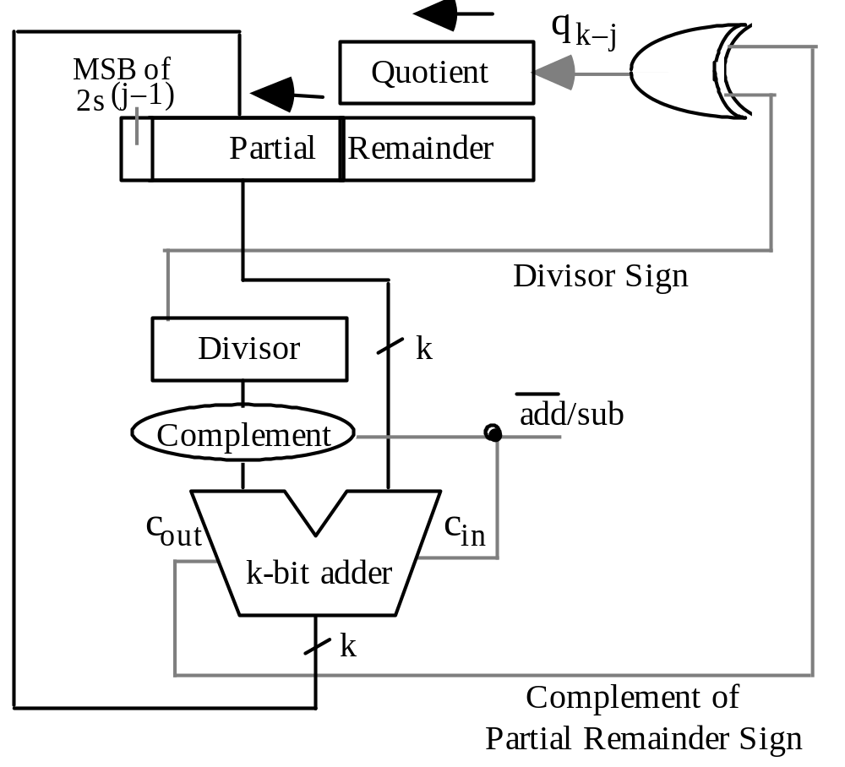
Nonrestoring Hardware Divider
Fig. 13.10 Shift-subtract sequential nonrestoring divider.
May 2020
Computer Arithmetic, Division
Slide <number>

Slide 26
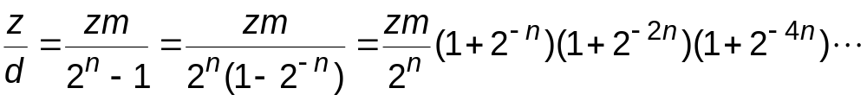
13.5 Division by Constants
Software and hardware aspects:
As was the case for multiplications by constants, optimizing compilers may replace some divisions by shifts/adds/subs; likewise, in custom VLSI circuits, hardware dividers may be replaced by simpler adders
Method 1: Find the reciprocal of the constant and multiply (particularly efficient if several numbers must be divided by the same divisor)
Method 2: Use the property that for each odd integer d, there exists an odd integer m such that d × m = 2 ^{n} – 1; hence, d = (2 ^{n} – 1)/m and
Multiplication by constant
Shift-adds
Number of shift-adds required is proportional to log k
May 2020
Computer Arithmetic, Division
Slide <number>

Slide 27

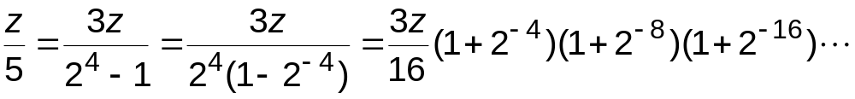
Example Division by a Constant
Example: Dividing the number z by 5, assuming 24 bits of precision.
We have d = 5, m = 3, n = 4; 5 × 3 = 2⁴ – 1
Instruction sequence for division by 5
q ← z + z shift-left 1 {3z computed}
q ← q + q shift-right 4 {3z(1 + 2^{–4}) computed}
q ← q + q shift-right 8 {3z(1 + 2^{–4})(1 + 2^{–8}) computed}
q ← q + q shift-right 16 {3z(1 + 2^{–4})(1 + 2^{–8})(1 + 2^{–16}) computed}
q ← q shift-right 4 {3z(1 + 2^{–4})(1 + 2^{–8})(1 + 2^{–16})/16 computed}
5 shifts
4 adds
May 2020
Computer Arithmetic, Division
Slide <number>

Slide 28
Numerical Examples for Division by 5
Instruction sequence for division by 5
q ← z + z shift-left 1 {3z computed}
q ← q + q shift-right 4 {3z(1 + 2^{–4}) computed}
q ← q + q shift-right 8 {3z(1 + 2^{–4})(1 + 2^{–8}) computed}
q ← q + q shift-right 16 {3z(1 + 2^{–4})(1 + 2^{–8})(1 + 2^{–16}) computed}
q ← q shift-right 4 {3z(1 + 2^{–4})(1 + 2^{–8})(1 + 2^{–16})/16 computed}
Computing 29 ÷ 5 (z = 29, d = 5)
87 ← 29 + 29 shift-left 1 {3z computed}
92 ← 87 + 87 shift-right 4 {3z(1 + 2^{–4}) computed}
92 ← 92 + 92 shift-right 8 {3z(1 + 2^{–4})(1 + 2^{–8}) computed}
92 ← 92 + 92 shift-right 16 {3z(1 + 2^{–4})(1 + 2^{–8})(1 + 2^{–16}) computed}
5 ← 92 shift-right 4 {3z(1 + 2^{–4})(1 + 2^{–8})(1 + 2^{–16})/16 computed}
Repeat the process for computing 30 ÷ 5 and comment on the outcome
May 2020
Computer Arithmetic, Division
Slide <number>

Slide 29
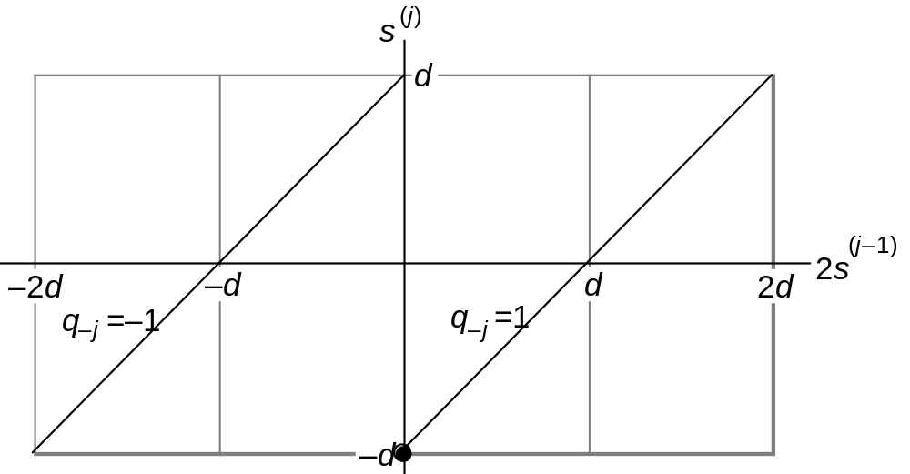
13.6 Radix-2 SRT Division
SRT division takes its name from Sweeney, Robertson, and Tocher, who independently discovered the method
s^{(j)} = 2s^{(j–1)} – q_{–j} d
with s⁽⁰⁾ = z
s^{(k)} = 2^{k}s
q_{–j} ∈ {⁻1, 1}
Fig. 13.11 The new partial remainder, s^{(j)}, as a function of the shifted old partial remainder, 2s^{(j–1)}, in radix-2 nonrestoring division.
May 2020
Computer Arithmetic, Division
Slide <number>

Slide 30
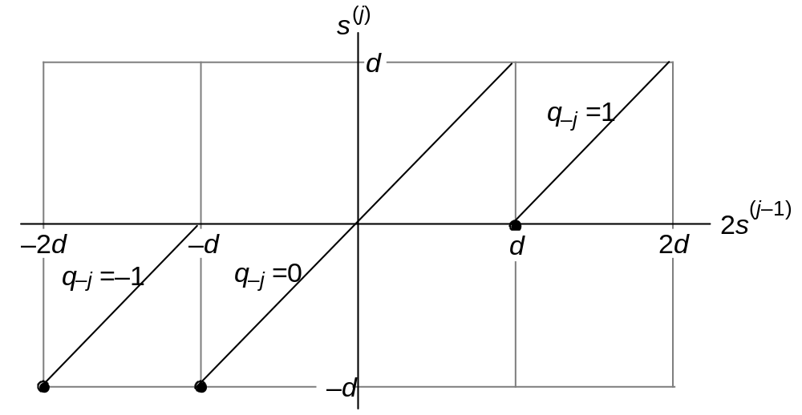
Allowing 0 as a Quotient Digit in Nonrestoring Division
This method was useful in early computers, because the choice q_{–j} = 0 requires shifting only, which was faster than shift-and-subtract
s^{(j)} = 2s^{(j–1)} – q_{–j} d
with s⁽⁰⁾ = z
s^{(k)} = 2^{k}s
q_{–j} ∈ {⁻1, 0, 1}
Fig. 13.12 The new partial remainder, s^{(j)}, as a function of the shifted old partial remainder, 2s^{(j–1)}, with q_{–j} in {−1, 0, 1}.
May 2020
Computer Arithmetic, Division
Slide <number>

Slide 31
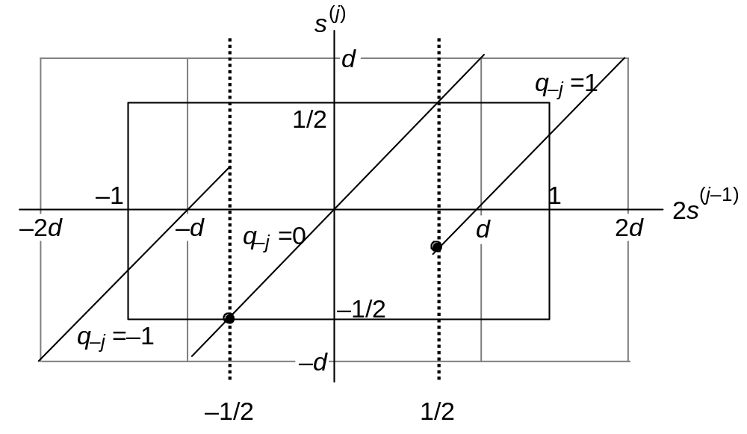
The Radix-2 SRT Division Algorithm
We use the comparison constants −½ and ½ for quotient digit selection
2s ≥ +½ means 2s = (0.1xxxxxxxx)_{2’s-compl}
2s < −½ means 2s = (1.0xxxxxxxx)_{2’s-compl}
s^{(j)} = 2s^{(j–1)} – q_{–j} d
with s⁽⁰⁾ = z
s^{(k)} = 2^{k}s
s^{(j)} ∈ [−½, ½ )
q_{–j} ∈ {⁻1, 0, 1}
Fig. 13.13 The relationship between new and old partial remainders in radix-2 SRT division.
May 2020
Computer Arithmetic, Division
Slide <number>

Slide 32
Radix-2 SRT Division with Variable Shifts
We use the comparison constants −½ and ½ for quotient digit selection
For 2s ≥ +½ or 2s = (0.1xxxxxxxx)_{2’s-compl} choose q_{–j} = 1
For 2s < −½ or 2s = (1.0xxxxxxxx)_{2’s-compl} choose q_{–j} = ⁻1
Choose q_{–j} = 0 in other cases, that is, for:
0 ≤ 2s < +½ or 2s = (0.0xxxxxxxx)_{2’s-compl}
−½ ≤ 2s < 0 or 2s = (1.1xxxxxxxx)_{2’s-compl}
Observation: What happens when the magnitude of 2s is fairly small?
2s = (0.00001xxxx)_{2’s-compl}
2s = (1.1110xxxxx)_{2’s-compl}
Choosing q_{–j} = 0 would lead to the same condition in the next step; generate 5 quotient digits 0 0 0 0 1
Generate 4 quotient digits 0 0 0 ⁻1
Use leading 0s or leading 1s detection circuit to determine how many quotient digits can be spewed out at once
Statistically, the average skipping distance will be 2.67 bits
May 2020
Computer Arithmetic, Division
Slide <number>

Slide 33
Example Unsigned Radix-2 SRT Division
In [−½, ½), so okay
========================
z . 0 1 0 0 0 1 0 1
d 0 . 1 0 1 0
–d 1 . 0 1 1 0
========================
s⁽⁰⁾ 0 . 0 1 0 0 0 1 0 1
2s⁽⁰⁾ 0 . 1 0 0 0 1 0 1 ≥ ½, so set q₋₁ = 1
+(−d) 1 . 0 1 1 0 and subtract
––––––––––––––––––––––––
s⁽¹⁾ 1 . 1 1 1 0 1 0 1
2s⁽¹⁾ 1 . 1 1 0 1 0 1 In [−½, ½), so set q₋₂ = 0
––––––––––––––––––––––––
s⁽²⁾ = 2s⁽¹⁾ 1 . 1 1 0 1 0 1
2s⁽²⁾ 1 . 1 0 1 0 1 In [−½, ½), so set q₋₃ = 0
––––––––––––––––––––––––
s⁽³⁾ = 2s⁽²⁾ 0 . 1 0 1 0 1
2s⁽³⁾ 1 . 0 1 0 1 < −½, so set q₋₄ = ⁻1
+d 0 . 1 0 1 0 and add
––––––––––––––––––––––––
s⁽⁴⁾ 1 . 1 1 1 1 Negative,
+d 0 . 1 0 1 0 so add to correct
––––––––––––––––––––––––
s⁽⁴⁾ 0 . 1 0 0 1
s 0 . 0 0 0 0 0 1 0 1
q 0 . 1 0 0⁻1 Uncorrected BSD quotient
q 0 . 0 1 1 0 Convert and subtract ulp
========================
0.1 Choose 1
1.0 Choose ⁻1
0.0/1.1 Choose 0
Fig. 13.14 Example of unsigned radix-2 SRT division.
May 2020
Computer Arithmetic, Division
Slide <number>

Slide 34
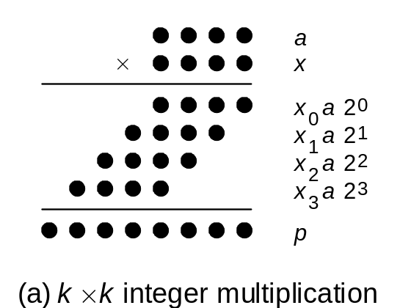
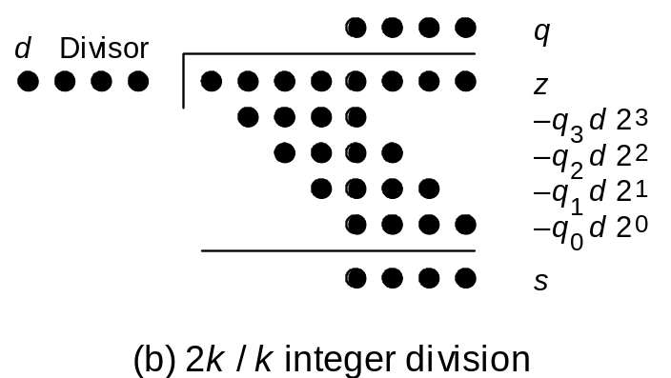
Preview of Fast Dividers
Multiplication and division as multioperand addition problems.
Like multiplication, division is multioperand addition
Thus, there are but two ways to speed it up:
a. Reducing the number of operands (divide in a higher radix)
b. Adding them faster (keep partial remainder in carry-save form)
There is one complication that makes division inherently more difficult:
The terms to be subtracted from (added to) the dividend are not
known a priori but become known as quotient digits are computed;
quotient digits in turn depend on partial remainders
May 2020
Computer Arithmetic, Division
Slide <number>

Slide 35
14 High-Radix Dividers
Chapter Goals
Study techniques that allow us to obtain
more than one quotient bit in each cycle
(two bits in radix 4, three in radix 8, . . .)
Chapter Highlights
Radix > 2 ⇒ quotient digit selection harder
Remedy: redundant quotient representation
Carry-save addition reduces cycle time
Quotient digit selection
Implementation methods and tradeoffs
May 2020
Computer Arithmetic, Division
Slide <number>

Slide 36
High-Radix Dividers: Topics
Topics in This Chapter
14.1 Basics of High-Radix Division
14.2 Using Carry-Save Adders
14.3 Radix-4 SRT Division
14.4 General High-Radix Dividers
14.5 Quotient Digit Selection
14.6 Using p-d Plots in Practice
May 2020
Computer Arithmetic, Division
Slide <number>

Slide 37
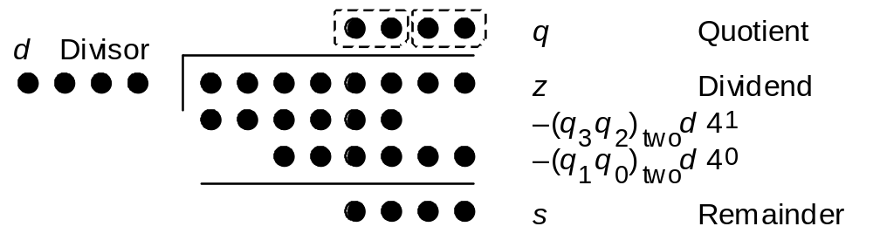
14.1 Basics of High-Radix Division
r z
Radices of practical interest are powers of 2, and perhaps 10
0
q_{k–j} r^{k} d
k digits
k digits
Division with left shifts
s^{(j)} = r s^{(j–1)} – q_{k–j} (r ^{k} d) with s⁽⁰⁾ = z and
|–shift–| s^{(k)} = r ^{k} s
|––– subtract –––|
Fig. 14.1
Radix-4 division in dot notation
May 2020
Computer Arithmetic, Division
Slide <number>

Slide 38
Difficulty of Quotient Digit Selection
What is the first quotient digit in the following radix-10 division?
_____________
2 0 4 3 | 1 2 2 5 7 9 6 8
12 / 2 = 6
122 / 20 = 6
1225 / 204 = 6
12257 / 2043 = 5
The problem with the pencil-and-paper division algorithm is that there is no room for error in choosing the next quotient digit
In the worst case, all k digits of the divisor and k + 1 digits in the partial remainder are needed to make a correct choice
Suppose we used the redundant signed digit set [–9, 9] in radix 10
Then, we could choose 6 as the next quotient digit, knowing that we can recover from an incorrect choice by using negative digits: 5 9 = 6 ⁻1
May 2020
Computer Arithmetic, Division
Slide <number>

Slide 39
Examples of High-Radix Division
Radix-4 integer division Radix-10 fractional division
====================== =================
z 0 1 2 3 1 1 2 3 z_{frac} . 7 0 0 3
4⁴d 1 2 0 3 d_{frac} . 9 9
====================== =================
s⁽⁰⁾ 0 1 2 3 1 1 2 3 s⁽⁰⁾ . 7 0 0 3
4s⁽⁰⁾ 0 1 2 3 1 1 2 3 10s⁽⁰⁾ 7 . 0 0 3
–q₃ 4⁴d 0 1 2 0 3 {q₃ = 1} –q_{–1}d 6 . 9 3 {q_{–1} = 7}
––––––––––––––––––––––– ––––––––––––––––––
s⁽¹⁾ 0 0 2 2 1 2 3 s⁽¹⁾ . 0 7 3
4s⁽¹⁾ 0 0 2 2 1 2 3 10s⁽¹⁾ 0 . 7 3
–q₂ 4⁴d 0 0 0 0 0 {q₂ = 0} –q_{–2}d 0 . 0 0 {q_{–2} = 0}
––––––––––––––––––––––– ––––––––––––––––––
s⁽²⁾ 0 2 2 1 2 3 s⁽²⁾ . 7 3
4s⁽²⁾ 0 2 2 1 2 3 s_{frac} . 0 0 7 3
–q₁ 4⁴d 0 1 2 0 3 {q₁ = 1} q_{frac} . 7 0
––––––––––––––––––––––– =================
s⁽³⁾ 1 0 0 3 3
4s⁽³⁾ 1 0 0 3 3
–q₀ 4⁴d 0 3 0 1 2 {q₀ = 2}
–––––––––––––––––––––––
s⁽⁴⁾ 1 0 2 1
s 1 0 2 1
q 1 0 1 2
======================
Fig. 14.2 Examples of
high-radix division with integer and fractional operands.
May 2020
Computer Arithmetic, Division
Slide <number>

Slide 40
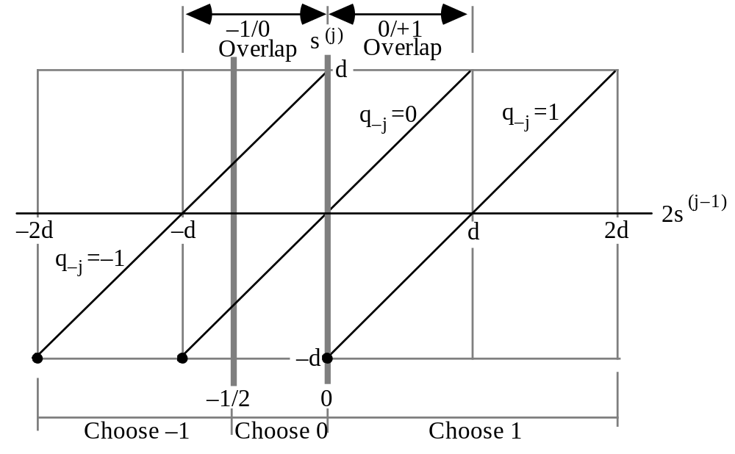
14.2 Using Carry-Save Adders
Fig. 14.3 Constant thresholds used for quotient digit selection in radix-2 division with q_{k–j} in {–1, 0, 1} .
May 2020
Computer Arithmetic, Division
Slide <number>

Slide 41
Quotient Digit Selection Based on Truncated PR
t := u_{[–2,1]} + v_{[–2,1]}
if t < –½
then q_{–j} = –1
else if t ≥ 0
then q_{–j} = 1
else q_{–j} = 0
endif
endif
Fig. 14.3
Sum part of 2s^{(j–1)}: u = (u₁u₀ . u_{–1}u_{–2} . . .)_{2’s-compl}
Carry part of 2s^{(j–1)}: v = (v₁v₀ . v_{–1}v_{–2} . . .)_{2’s-compl}
Approximation to the partial remainder:
t = u_{[–2,1]} + v_{[–2,1]} {Add the 4 MSBs of u and v}
Max error in approximation
< ¼ + ¼ = ½
Error in [0, ½)
May 2020
Computer Arithmetic, Division
Slide <number>

Slide 42
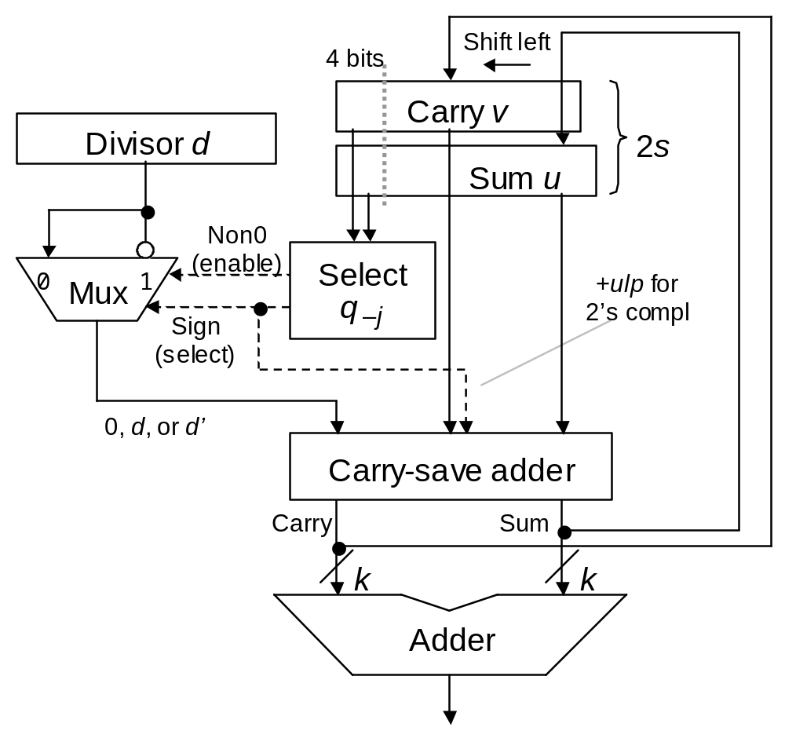
Divider with Partial Remainder in Carry-Save Form
Fig. 14.4 Block diagram of a radix-2 divider with partial remainder in stored-carry form.
May 2020
Computer Arithmetic, Division
Slide <number>

Slide 43
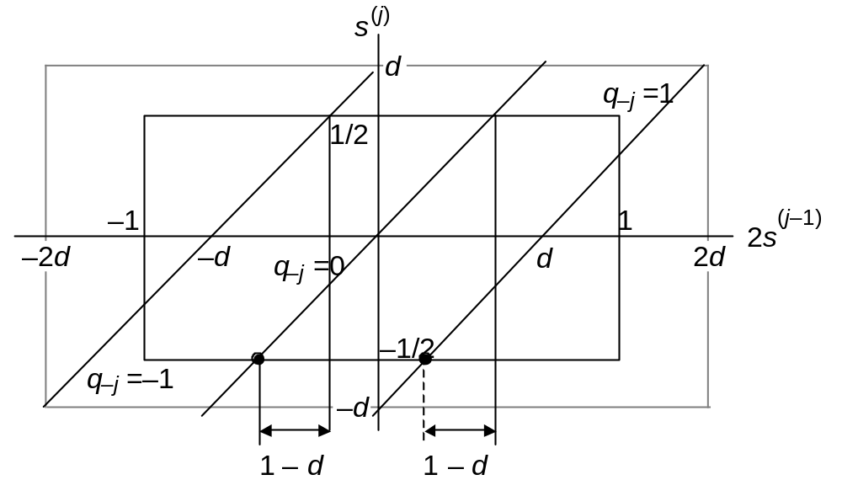
Why We Cannot Use Carry-Save PR with SRT Division
Fig. 14.5 Overlap regions in radix-2 SRT division.
May 2020
Computer Arithmetic, Division
Slide <number>

Slide 44
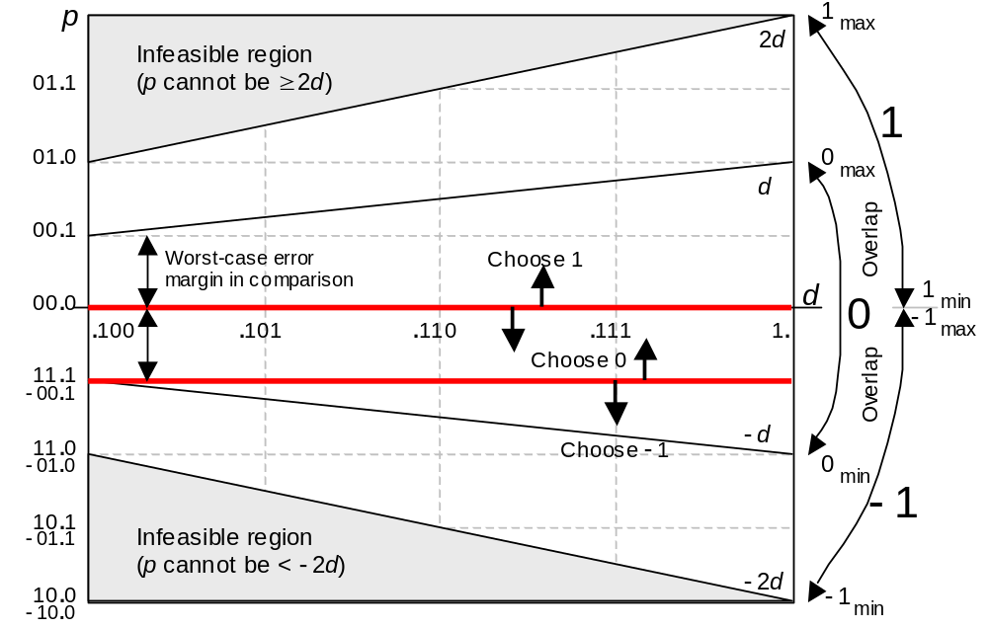
14.4 Choosing the Quotient Digits
Fig. 14.3
Fig. 14.6 A p-d plot for radix-2 division with d ∈ [1/2,1), partial remainder in [–d, d), and quotient digits in [–1, 1].
May 2020
Computer Arithmetic, Division
Slide <number>

Slide 45
Design of the Quotient Digit Selection Logic
Shifted sum =
(u₁u₀ . u₋₁u₋₂ . . .)_{2’s-compl}
t := u_{[–2,1]} + v_{[–2,1]}
if t < –½
then q_{–j} = –1
else if t ≥ 0
then q_{–j} = 1
else q_{–j} = 0
endif
endif
Shifted carry =
(v₁v₀ . v₋₁v₋₂ . . .)_{2’s-compl}
4-bit adder
Approx shifted PR = (t₁t₀ . t₋₁t₋₂)_{2’s-compl}
Combinational
logic
Non0 = t₁′ ∨ t₀′ ∨ t_{–1}′ = (t₁ t₀ t₋₁)′
Sign = t₁ (t₀′ ∨ t₋₁′)
Sign
Non0
May 2020
Computer Arithmetic, Division
Slide <number>

Slide 46
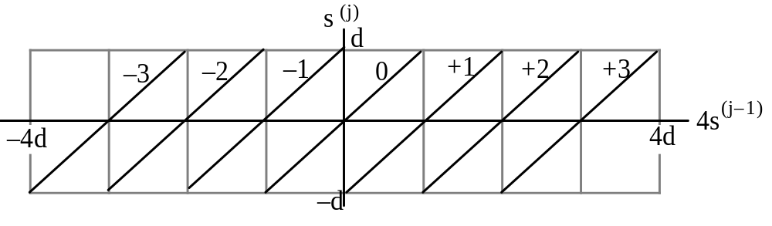
14.3 Radix-4 SRT Division
Radix-4 fractional division with left shifts and q_{–j} ∈ [–3, 3]
s^{(j)} = 4 s^{(j–1)} – q_{–j} d with s⁽⁰⁾ = z and s^{(k)} = 4^{k} s
|–shift–|
|–– subtract ––|
Fig. 14.7 New versus shifted old partial remainder in radix-4 division with q_{–j} in [–3, 3].
Two difficulties:
How do you choose from among the 7 possible values for q_{−j}?
If the choice is +3 or −3, how do you form 3d?
May 2020
Computer Arithmetic, Division
Slide <number>

Slide 47
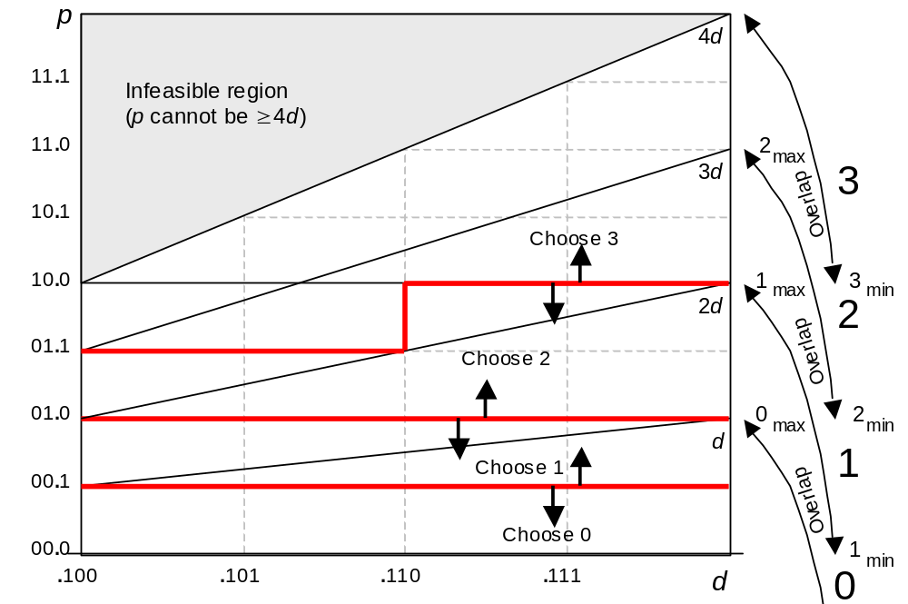
Building the p-d Plot for Radix-4 Division
Uncertainty
region
Uncertainty
region
Fig. 14.8 A p-d plot for radix-4 SRT division with quotient digit set [–3, 3].
May 2020
Computer Arithmetic, Division
Slide <number>

Slide 48
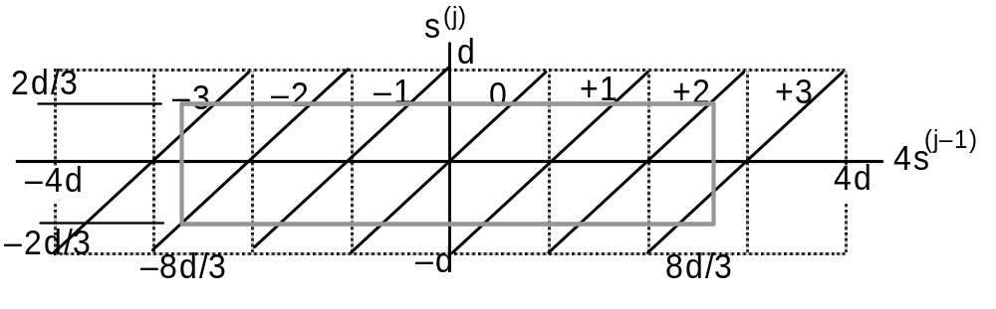
Restricting the Quotient Digit Set in Radix 4
Radix-4 fractional division with left shifts and q_{–j} ∈ [–2, 2]
s^{(j)} = 4 s^{(j–1)} – q_{–j} d with s⁽⁰⁾ = z and s^{(k)} = 4^{k} s
|–shift–|
|–– subtract ––|
Fig. 14.9 New versus shifted old partial remainder in radix-4 division with q_{–j} in [–2, 2].
For this restriction to be feasible, we must have:
s ∈ [−hd, hd) for some h < 1, and 4hd – 2d ≤ hd
This yields h ≤ 2/3 (choose h = 2/3 to minimize the restriction)
May 2020
Computer Arithmetic, Division
Slide <number>

Slide 49
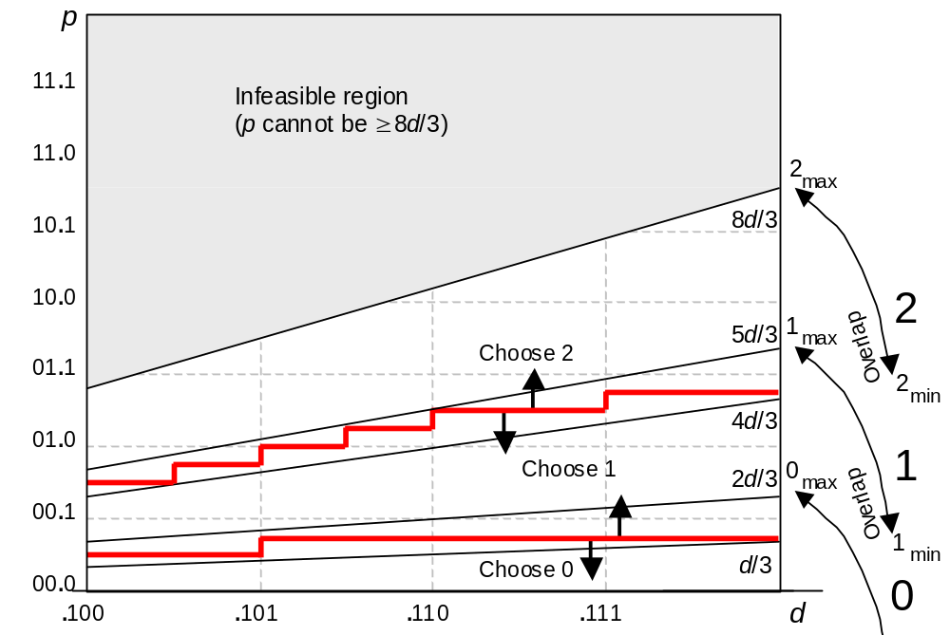
Building the p-d Plot with Restricted Radix-4 Digit Set
Fig. 14.10 A p-d plot for radix-4 SRT division with quotient digit set [–2, 2].
May 2020
Computer Arithmetic, Division
Slide <number>

Slide 50
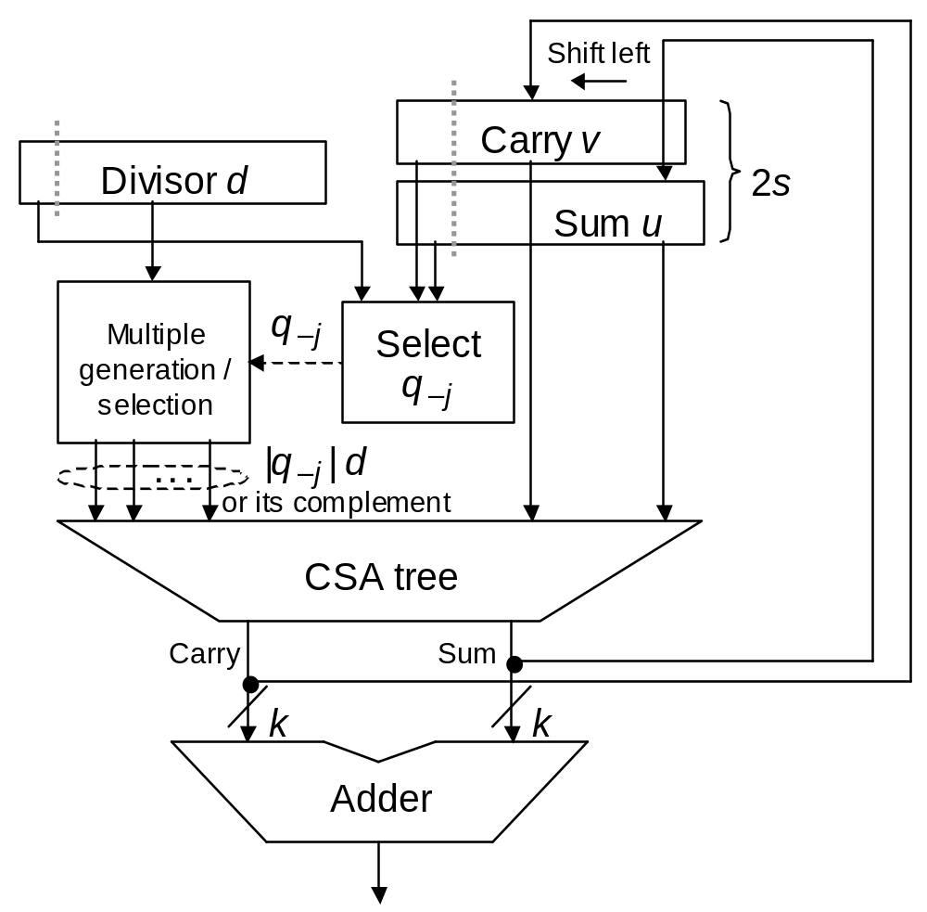
14.4 General High-Radix Dividers
Process to derive the details:
Radix r
Digit set [–α, α] for q_{–j}
Number of bits of p (v and u) and d to be inspected
Quotient digit selection unit (table or logic)
Multiple generation/selection scheme
Conversion of redundant q to 2’s complement
Fig. 14.11 Block diagram of radix-r divider with partial remainder in stored-carry form.
May 2020
Computer Arithmetic, Division
Slide <number>

Slide 51
Multiple Generation for High-Radix Division
Example: Digit set [–6, 6] for r = 8
Option 1: precompute 3a and 5a
Option 2: generate a multiple
|q_{–j}|a as a set of two numbers,
one chosen from {0, a, 2a}
and another from {0, a, 4a}
0 a 2a
0 a 4a
0 1 2
0 1 2
May 2020
Computer Arithmetic, Division
Slide <number>

Slide 52
14.5 Quotient Digit Selection
Radix-r division with quotient digit set [–α, α], α < r – 1
Restrict the partial remainder range, say to [–hd, hd)
From the solid rectangle in Fig. 15.1, we get rhd – αd ≤ hd or h ≤ α/(r – 1)
To minimize the range restriction, we choose h = α/(r – 1)
Example: r = 4, α = 2 ➔ h = 2/3
s^{(j)}
d
hd
hd
–r + 1
. . .
–α
. . .
–1
0
+1
. . .
+α
. . .
r – 1
rs^{(j–1)}
–rd
–αd
–d
0
d
αd
rd
–hd
–hd
–rhd
–d
rhd
Fig. 14.12 The relationship between new and shifted old partial remainders in radix-r division with quotient digits in [–α, +α].
May 2020
Computer Arithmetic, Division
Slide <number>

Slide 53
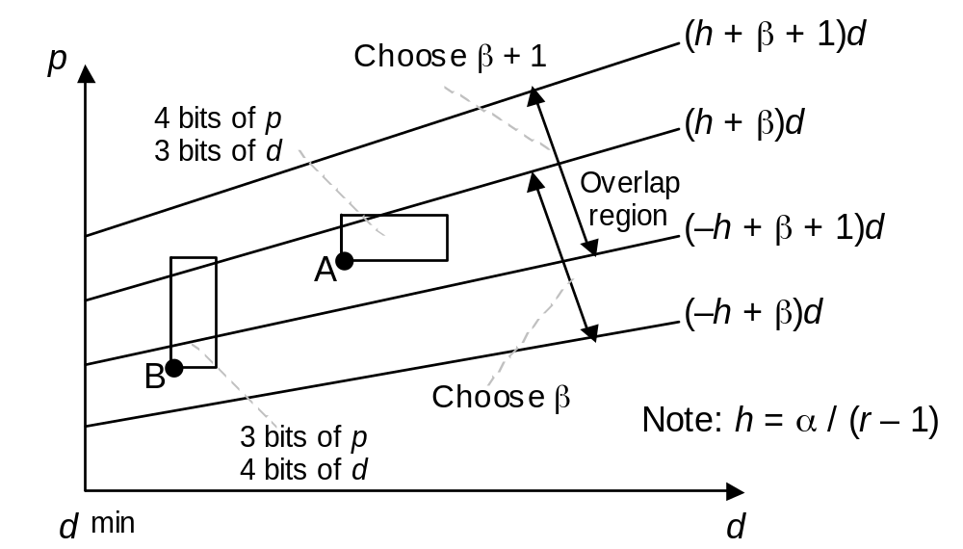
Why Using Truncated p and d Values Is Acceptable
Standard p
xx.xxxx
Carry-save p
xx.xxxxx
xx.xxxxx
Fig. 14.13 A part of p-d plot showing the overlap region for choosing the quotient digit value β or β+1 in radix-r division with quotient digit set [–α, α].
May 2020
Computer Arithmetic, Division
Slide <number>

Slide 54
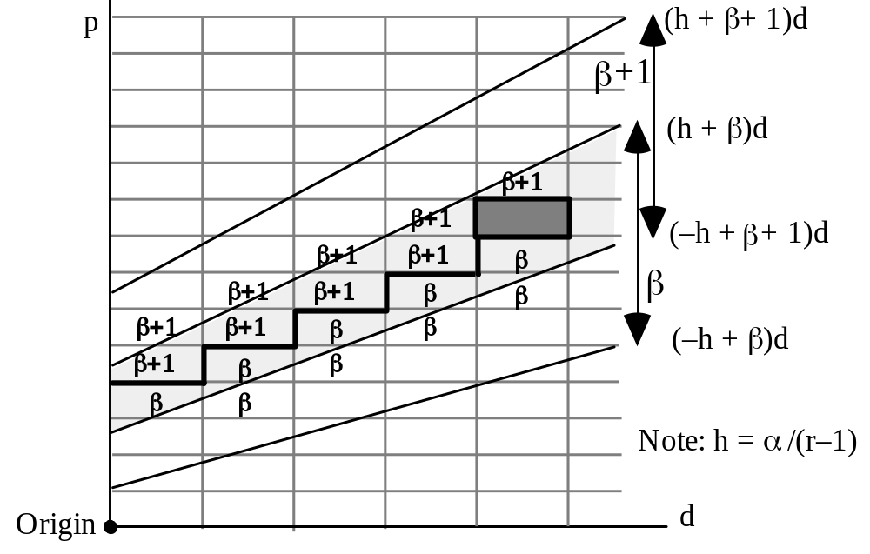
Table Entries in the Quotient Digit Selection Logic
Fig. 14.14 A part of p-d plot showing an overlap region and its staircase-like selection boundary.
May 2020
Computer Arithmetic, Division
Slide <number>

Slide 55
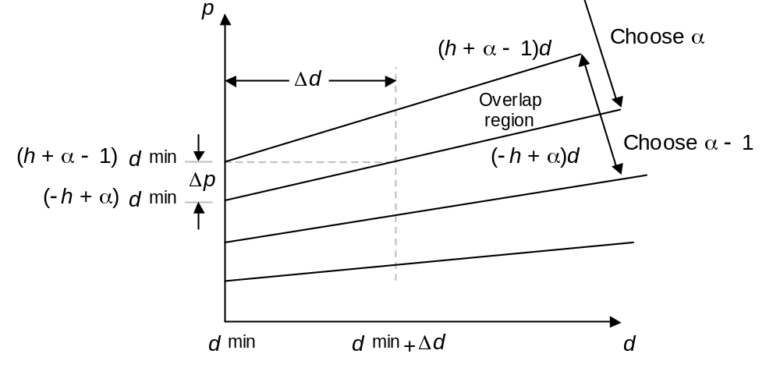
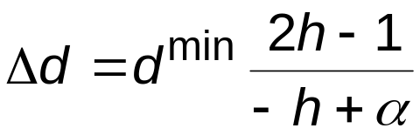

14.6 Using p-d Plots in Practice
Smallest Δd occurs for the overlap region of α and α – 1
Fig. 14.15 Establishing upper bounds on the dimensions of uncertainty rectangles.
May 2020
Computer Arithmetic, Division
Slide <number>

Slide 56
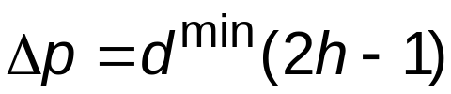
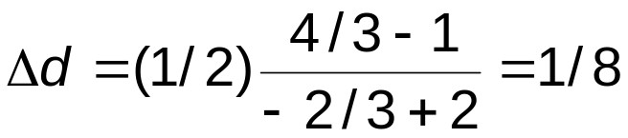

Example: Lower Bounds on Precision
Fig. 14.15
For r = 4, divisor range [0.5, 1), digit set [–2, 2], we have α = 2,
d ^{min} = 1/2, h = α/(r – 1) = 2/3
Because 1/8 = 2^{–3} and 2^{–3} ≤ 1/6 < 2^{–2}, we must inspect at least 3 bits of d (2, given its leading 1) and 3 bits of p
These are lower bounds and may prove inadequate
In fact, 3 bits of p and 4 (3) bits of d are required
With p in carry-save form, 4 bits of each component must be inspected
May 2020
Computer Arithmetic, Division
Slide <number>

Slide 57
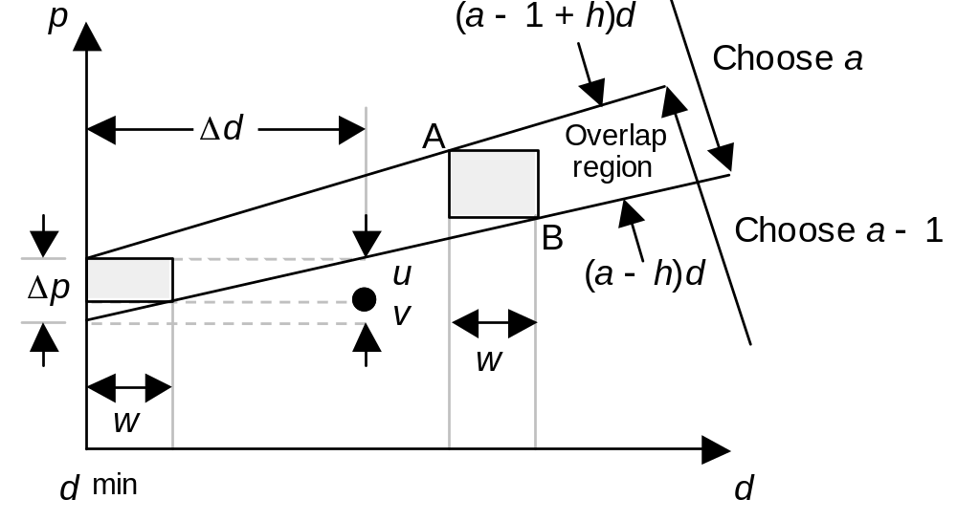
Upper Bounds for Precision
Theorem: Once lower bounds on precision are determined based on Δd and Δp, one more bit of precision in each direction is always adequate
Proof: Let w be the spacing of vertical grid lines
w ≤ Δd/2 ⇒ v ≤ Δp/2 ⇒ u ≥ Δp/2
May 2020
Computer Arithmetic, Division
Slide <number>

Slide 58
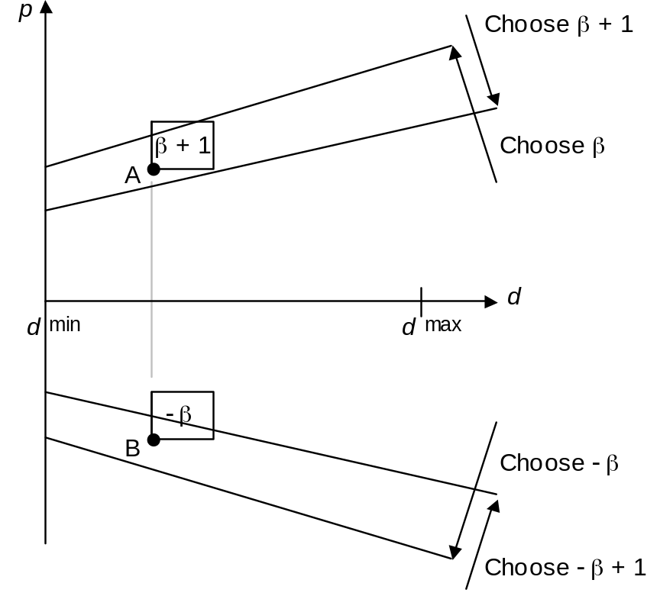
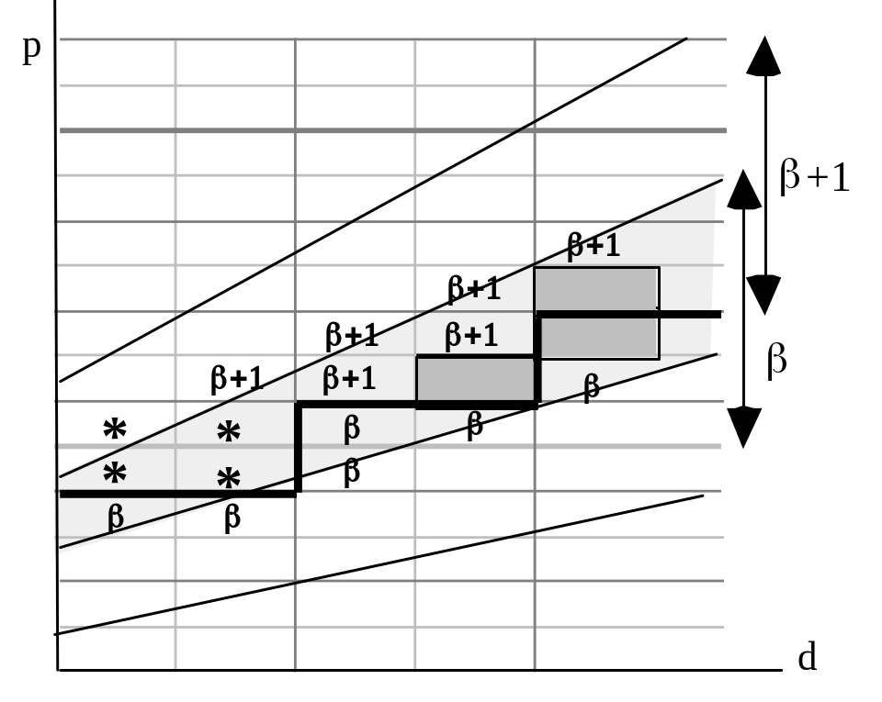
Some Implementation Details
Fig. 14.17 Example of p-d plot allowing larger uncertainty rectangles, if the 4 cases marked with asterisks are handled as exceptions.
Fig. 14.16 The asymmetry of quotient digit selection process.
May 2020
Computer Arithmetic, Division
Slide <number>

Slide 59
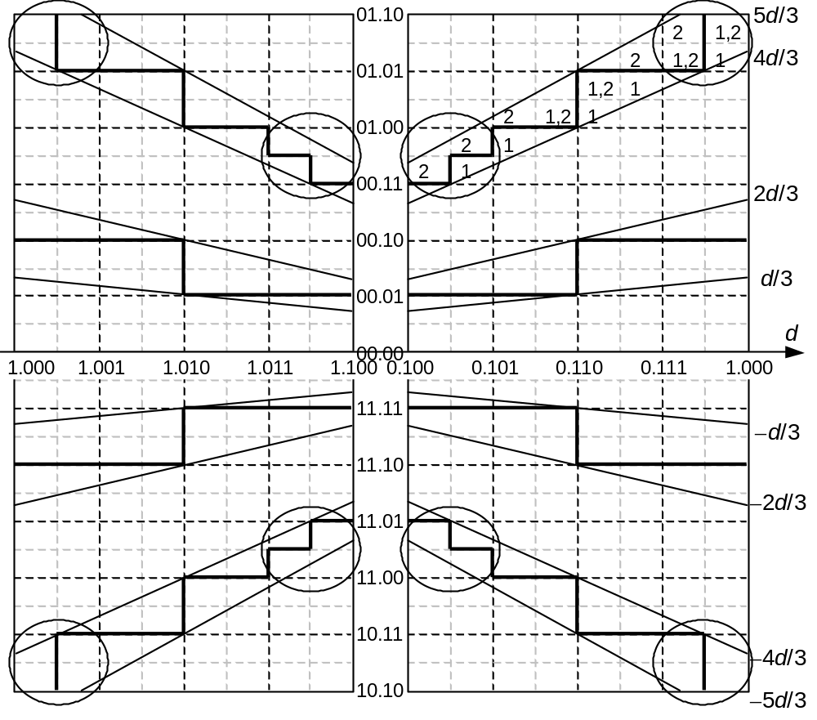
A Complete p-d Plot
Radix r = 4
q_{–j} in [–2, 2]
d in [1/2, 1)
p in [–8/3, 8/3]
Explanation
of the Pentium division bug
May 2020
Computer Arithmetic, Division
Slide <number>

Slide 60
15 Variations in Dividers
Chapter Goals
Discuss some variations in implementing
division schemes and cover combinational,
modular, and merged hardware dividers
Chapter Highlights
Prescaling simplifies q digit selection
Overlapped q digit selection
Parallel hardware (array) dividers
Shared hardware in multipliers/dividers
Square-rooting not special case of division
May 2020
Computer Arithmetic, Division
Slide <number>

Slide 61
Variations in Dividers: Topics
Topics in This Chapter
15.1 Division with Prescaling
15.2 Overlapped Quotient Digit Selection
15.3 Combinational and Array Dividers
15.4 Modular Dividers and Reducers
15.5 The Special Case of Reciprocation
15.6 Combined Multiply/Divide Units
May 2020
Computer Arithmetic, Division
Slide <number>

Slide 62
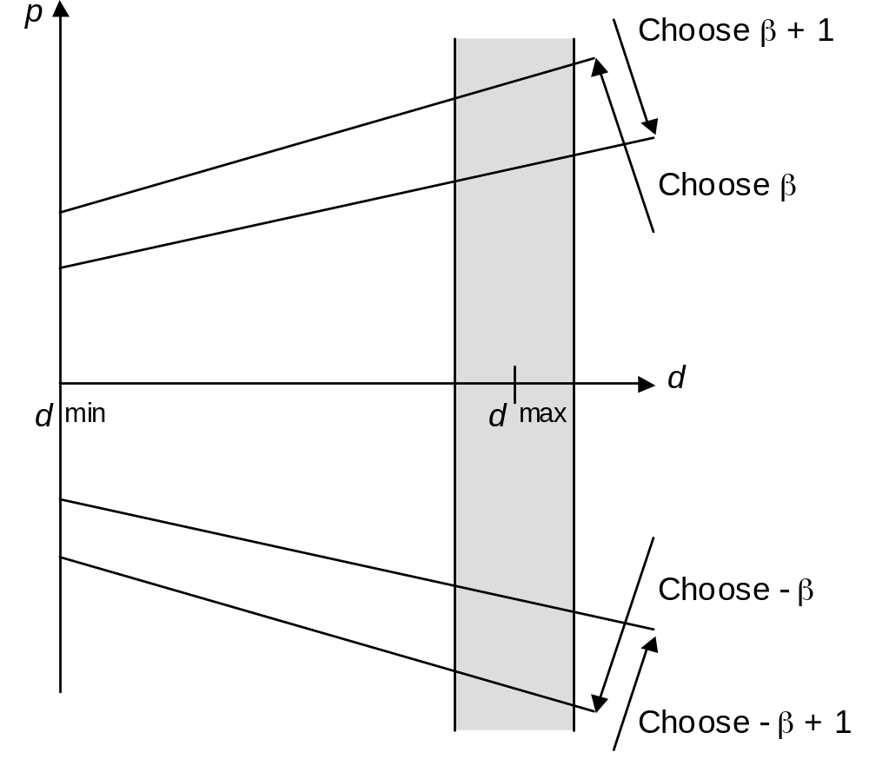
15.1 Division with Prescaling
Overlap regions of a p-d plot are wider toward the high end of the divisor range
If we can restrict the magnitude of the divisor to an interval close to d^{max} (say 1 – ε < d < 1 + δ, when d^{max} = 1), quotient digit selection may become simpler
Thus, we perform the division (zm)/(dm) for a suitably chosen scale factor m (m > 1)
Prescaling (multiplying z and d by m) should be done without real multiplications
Restricting the divisor to the shaded area simplifies quotient digit selection.
May 2020
Computer Arithmetic, Division
Slide <number>

Slide 63
Examples of Prescaling
Example 1: Unsigned divisor d in [1/2, 1)
When d ∈ [1/2, 3/4), multiply by 1½ [d begins 0.10…]
The prescaled divisor will be in [1 – 1/4, 1 + 1/8)
Example 2: Unsigned divisor d in [1/2, 1)
Case d ∈
[1/2, 9/16), it begins with 0.1000…, multiply by 2
[9/16, 5/8), it begins with 0.1001…, multiply by 1 + 1/2
[5/8, 3/4), it begins with 0.101…, multiply by 1 + 1/2
[3/4, 1), it begins with 0.11…, multiply by 1 + 1/8
[1/2, 9/16) × 2 = [1, 1 + 1/8)
[9/16, 5/8) × (1 + 1/2) = [1 – 5/32, 1 – 1/16)
[5/8, 3/4) × (1 + 1/2) = [1 – 1/16, 1 + 1/8)
[3/4, 1) × (1 + 1/8) = [1 – 5/32, 1 + 1/8)
The prescaled divisor will be in [1 – 5/32, 1 + 1/8)
May 2020
Computer Arithmetic, Division
Slide <number>

Slide 64
15.2 Overlapped Quotient Digit Selection
Alternative to high-radix design when q digit selection is too complex
Sum
Carry
–d
d
–d 0 d
CSA
CSA
Compute the next partial remainder and resulting q digit for all possible choices of the current q digit
q_{k–j}
CSA
q_{k–j}
Quotient digit selector
–d 0 d
Mux
This is the same idea as carry-select addition
q_{k–j+1}
CSA
Signal bundle
A few bits
Speculative computation (throw transistors at the delay problem) is common in modern systems
Fig. 15.1 Overlapped radix-2 quotient digit selection for radix-4 division. A dashed line represents a signal pair that denotes a quotient digit value in [–1, 1].
May 2020
Computer Arithmetic, Division
Slide <number>

Slide 65
15.3 Combinational and Array Dividers
Can take the notion of overlapped q digit selection to the extreme of selecting all q digits at once → Exponential complexity
By contrast, a fully combinational tree multiplier
has O(log k) latency and O(k²) cost
O(k log k) conjectured
Can we do as well as multipliers, or at least better than exponential cost, for logarithmic-time dividers?
Complexity theory results: It is possible to design dividers
with O(log k) latency and O(k⁴) cost
with O(log k log log k) latency and O(k²) cost
These theoretical constructions have not led to practical designs
May 2020
Computer Arithmetic, Division
Slide <number>

Slide 66
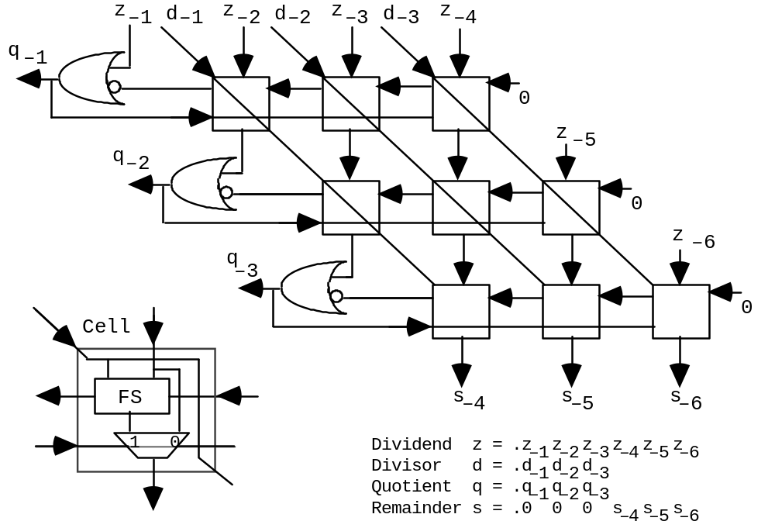
Restoring Array Divider
Fig. 15.7 Restoring array divider composed of controlled subtractor cells.
May 2020
Computer Arithmetic, Division
Slide <number>

Slide 67
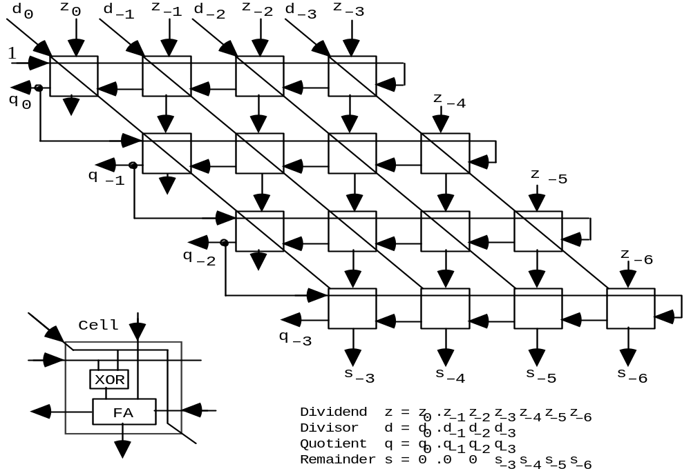
Nonrestoring Array Divider
Fig. 15.8 Nonrestoring
array divider built of controlled add/subtract cells.
Similarity to array multiplier is deceiving
Critical path
May 2020
Computer Arithmetic, Division
Slide <number>

Slide 68
Speedup Methods for Array Dividers
Idea: Pass the partial remainder downward in carry-save form to speed up the operation of each row
Critical path
Fig. 15.8
However, we still need to know the carry/borrow-out from each row
Solution: Insert a carry-lookahead circuit between successive rows
Not very cost-effective; thus not used in practice
May 2020
Computer Arithmetic, Division
Slide <number>

Slide 69
15.4 Modular Dividers and Reducers
Given dividend z and divisor d, with d ≥ 0, a modular divider computes
q = ⎣z / d⎦ and s = z mod d = ⟨z⟩_{d}
The quotient q is, by definition, an integer but the inputs z and d do not have to be integers; the modular remainder is always positive
Example:
⎣–3.76 / 1.23⎦ = –4 and ⟨–3.76⟩_{1.23} = 1.16
The quotient and remainder of ordinary division are −3 and −0.07
A modular reducer computes only the modular remainder and is in many cases simpler than a full-blown divider
May 2020
Computer Arithmetic, Division
Slide <number>

Slide 70
Montgomery Modular Reduction
Very efficient for reducing large numbers (100s of bits wide)
The radix-2 version below is suitable for low-cost hardware realization
Software versions are based on radix 2³² or 2⁶⁴ (1 word = 1 digit)
Problem: Compute q = ax mod m, where m < 2^{k}
Straightforward solution: Compute ax as usual; then reduce mod m
Incremental reduction after adding each partial product is more efficient
Assume a, x, q, and other values are k-bit pseudoresidues (can be > m)
Pick R such that R = 1 mod m
Montgomery multiplication computes axR^{–1} mod m, instead of ax mod m
Represent any number y as yR mod m (known as the M-code for y)
R = 1 mod m ensures that numbers in [0, m – 1] have distinct M-codes
Multiplication: t = (aR)(xR)R^{–1} mod m = (ax)R mod m = M-code for ax
Initial conversion: Find yR by applying Montgomery’s method to y and R²
Final reconversion: Find y from t = yR by M-multiplying 1 and t
May 2020
Computer Arithmetic, Division
Slide <number>

Slide 71
Example Montgomery Modular Multiplication
======================= ===============
a 1 0 1 0 a 1 0 1 0
2⁴x 1 0 1 1 x 1 0 1 1
======================= ===============
p(0) 0 0 0 0 p(0) 0 0 0 0
+x0a 1 0 1 0 +x0a 1 0 1 0
–––––––––––––––––––––––– –––––––––––––––
2p(1) 0 1 0 1 0 2p(1) 0 1 0 1 0 Even
p(1) 0 1 0 1 0 p(1) 0 1 0 1
+x1a 1 0 1 0 +x1a 1 0 1 0
–––––––––––––––––––––––– –––––––––––––––
2p(2) 0 1 1 1 1 0 2p(2) 0 1 1 1 1 Odd
p(2) 0 1 1 1 1 0 +13 1 1 0 1
+x2a 0 0 0 0 –––––––––––––––
–––––––––––––––––––––––– 2p(2) 1 1 1 0 0
2p(3) 0 0 1 1 1 1 0 p(2) 1 1 1 0
p(3) 0 0 1 1 1 1 0 +x2a 0 0 0 0
+x3a 1 0 1 0 –––––––––––––––
–––––––––––––––––––––––– 2p(3) 0 1 1 1 0 Even
2p(4) 0 1 1 0 1 1 1 0 p(3) 0 1 1 1
p(4) 0 1 1 0 1 1 1 0 +x3a 1 0 1 0
======================= –––––––––––––––
2p(4) 1 0 0 0 1 Odd
+13 1 1 0 1
–––––––––––––––
2p(4) 1 1 1 1 0
p(4) 1 1 1 1
===============
Fig. 15.4
(a) Ordinary
Example: r = 2; m = 13;
R = 16 = r ⁴; R ^{–1} = 9 mod 13
(because 16 × 9 = 1 mod 13)
(b) Mod 13
May 2020
Computer Arithmetic, Division
Slide <number>

Slide 72
Advantages of Montgomery’s Method
Standard reduction is based on subtracting a multiple of m from the result depending on the most significant bit(s)
However, MSBs are not readily known if we use carry-save numbers
In Montgomery reduction, the decision is based on LSB(s), thus allowing the use of carry-save arithmetic as well as parallel processing
May 2020
Computer Arithmetic, Division
Slide <number>

Slide 73
15.5 The Special Case of Reciprocation
y
y
1
y
a
x
z
d
z
d
Multiplier
Divider
Divider
p = ax
q = z / d
q = z / d
y²
√ y
1 / y
(a) Squaring
(b) Square-rooting?
(c) Reciprocation
Fig. 15.5 Square-rooting is not a special case of division, but reciprocation is.
Key question: Is reciprocation any faster than division?
Answer: Not if a conventional digit recurrence algorithm is used
May 2020
Computer Arithmetic, Division
Slide <number>

Slide 74
Doubling the Speed of Reciprocation
Q ≈ 1/d with error ≤ 2^{–k/2}
t = Q(2 – Qd) ≈ 1/d; error ≤ 2^{–k}
s^{(j+1)} = 2s^{(j)} – q_{–j} d, with 2s⁽⁰⁾ = 1
t^{(j+1)} = 4t^{(j)} + q_{–j} (4s^{(j)} – q_{–j} d), with t⁽⁰⁾ = 0
q_{–j}
d
A: Digit-recurrence reciprocation to obtain
Q ≈ 1/d
s^{(j)}
B: Digit-recurrence refinement to obtain
q = Q(2 – Qd)
q
Iterations for box A
Time saved
Iterations for box B
Iterations for simple digit-recurrence reciprocation
Fig. 15.6 Hybrid evaluation of the reciprocal 1/d by an approximate reciprocation stage and a refinement stage that operate concurrently.
May 2020
Computer Arithmetic, Division
Slide <number>

Slide 75
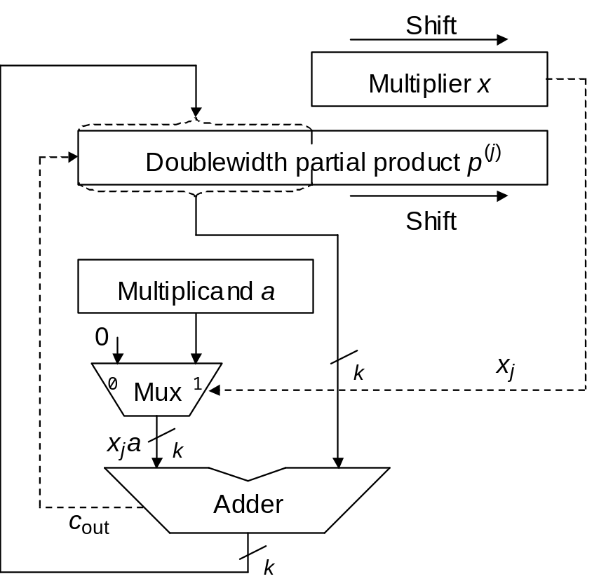
15.6 Combined Multiply/Divide Units
Similarity of blocks in multipliers and dividers (only shift direction is different)
Fig. 9.4
Fig. 13.10
May 2020
Computer Arithmetic, Division
Slide <number>

Slide 76
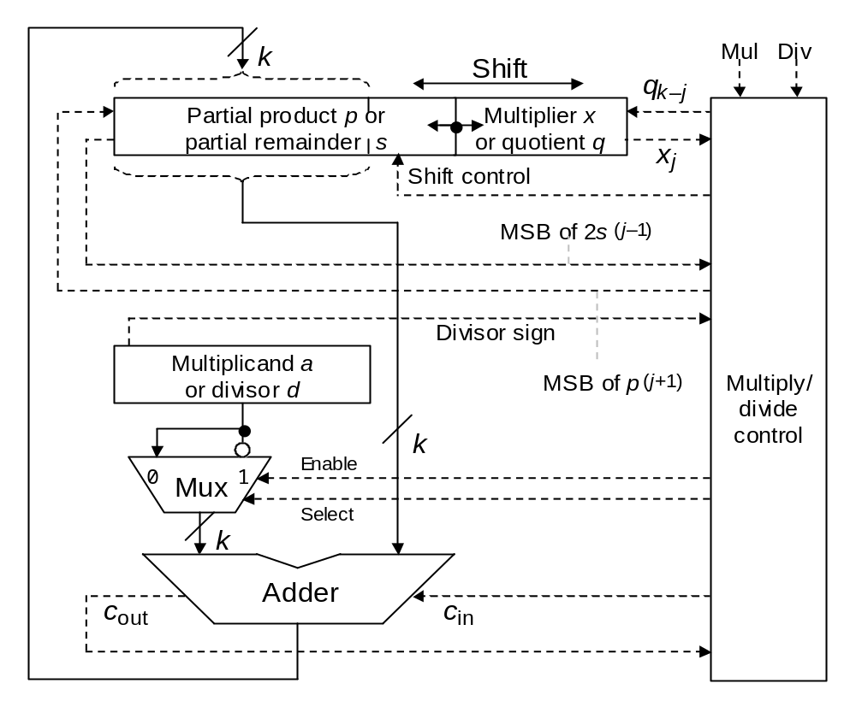
Single Unit for Sequential Multiplication and Division
The control unit proceeds through necessary steps for multiplication or division
(including using the appropriate shift direction)
The slight speed penalty owing to a more complex control unit is insignificant
Fig. 15.9 Sequential radix-2 multiply/divide unit.
May 2020
Computer Arithmetic, Division
Slide <number>

Slide 77
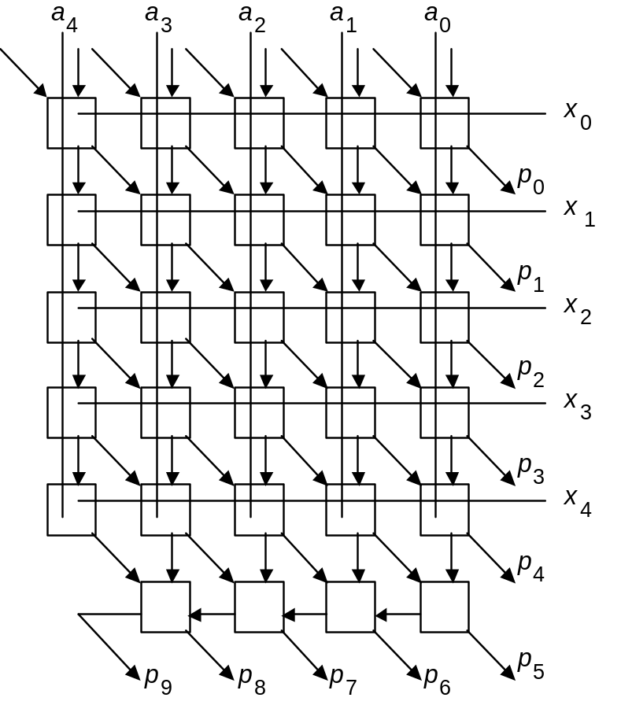
Similarities of Array Multipliers and Array Dividers
Fig. 11.4
Fig. 15.8
May 2020
Computer Arithmetic, Division
Slide <number>

Slide 78
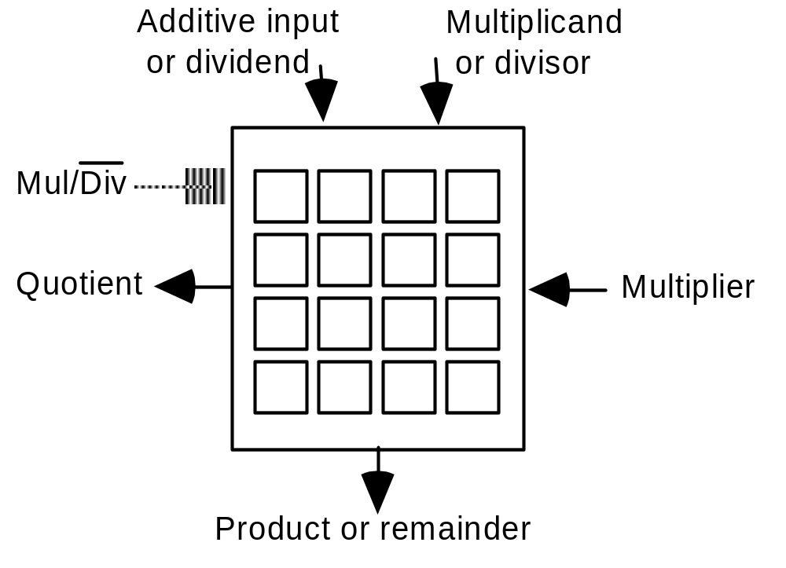
Single Unit for Array Multiplication and Division
Each cell within the array can act as a modified adder or modified subtractor based on control input values
In some designs, squaring and square-rooting functions are also included within the same array
Fig. 15.10 I/O specification of a universal circuit that can act as an array multiplier or array divider.
May 2020
Computer Arithmetic, Division
Slide <number>

Slide 79
16 Division by Convergence
Chapter Goals
Show how by using multiplication as the
basic operation in each division step,
the number of iterations can be reduced
Chapter Highlights
Digit-recurrence as convergence method
Convergence by Newton-Raphson iteration
Computing the reciprocal of a number
Hardware implementation and fine tuning
May 2020
Computer Arithmetic, Division
Slide <number>

Slide 80
Division by Convergence: Topics
Topics in This Chapter
16.1 General Convergence Methods
16.2 Division by Repeated Multiplications
16.3 Division by Reciprocation
16.4 Speedup of Convergence Division
16.5 Hardware Implementation
16.6 Analysis of Lookup Table Size
May 2020
Computer Arithmetic, Division
Slide <number>

Slide 81
16.1 General Convergence Methods
Sequential digit-at-a-time (binary or high-radix) division
can be viewed as a convergence scheme
As each new digit of q = z / d is determined, the quotient value
is refined, until it reaches the final correct value
Convergence is from below in restoring division and oscillating
in nonrestoring division
q
Meanwhile,
the remainder
s = z – q × d approaches 0;
the scaled remainder is kept in a certain range, such as [– d, d)
1
0.101101
0
Digit
May 2020
Computer Arithmetic, Division
Slide <number>

Slide 82
Elaboration on Scaled Remainder in Division
The partial remainder s^{(j)} in division recurrence isn’t the true remainder but a version scaled by 2^{j}
Division with left shifts
s^{(j)} = 2s^{(j–1)} – q_{k–j} (2^{k} d) with s⁽⁰⁾ = z and
|–shift–| s^{(k)} = 2^{k}s
|––– subtract –––|
q
Quotient digit selection keeps the scaled remainder bounded (say, in the range
–d to d) to ensure the convergence of the true remainder to 0
1
0.101101
0
Digit
May 2020
Computer Arithmetic, Division
Slide <number>

Slide 83
Recurrence Formulas for Convergence Methods
u ^{(i+1)} = f(u ^{(i)}, v ^{(i)})
v ^{(i+1)} = g(u ^{(i)}, v ^{(i)})
Constant
u ^{(i+1)} = f(u ^{(i)}, v ^{(i)}, w ^{(i)})
v ^{(i+1)} = g(u ^{(i)}, v ^{(i)}, w ^{(i)})
w ^{(i+1)} = h(u ^{(i)}, v ^{(i)}, w ^{(i)})
Desired
function
Guide the iteration such that one of the values converges to a constant (usually 0 or 1)
The other value then converges to the desired function
The complexity of this method depends on two factors:
a. Ease of evaluating f and g (and h)
b. Rate of convergence (number of iterations needed)
May 2020
Computer Arithmetic, Division
Slide <number>

Slide 84
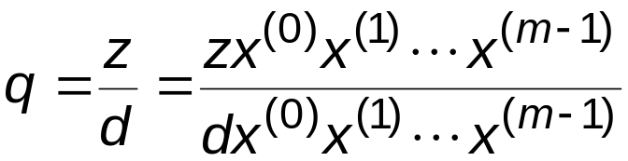
16.2 Division by Repeated Multiplications
Motivation: Suppose add takes 1 clock and multiply 3 clocks;
64-bit divide takes 64 clocks in radix 2, 32 in radix 4
→ Divide via multiplications faster if 10 or fewer needed
Idea:
Converges to q
Force to 1
Remainder often not needed, but can be obtained by another multiplication if desired: s = z – qd
To turn the identity into a division algorithm, we face three questions:
1. How to select the multipliers x^{(i)} ?
2. How many iterations (pairs of multiplications)?
3. How to implement in hardware?
May 2020
Computer Arithmetic, Division
Slide <number>

Slide 85
Formulation as a Convergence Computation
Idea:
Converges to q
Force to 1
d ^{(i+1)} = d ^{(i)} x ^{(i)} Set d ⁽⁰⁾ = d; make d ^{(m)} converge to 1
z ^{(i+1)} = z ^{(i)} x ^{(i)} Set z ⁽⁰⁾ = z; obtain z/d = q ≅ z ^{(m)}
Question 1: How to select the multipliers x ^{(i)} ? x ^{(i)} = 2 – d ^{(i)}
This choice transforms the recurrence equations into:
d ^{(i+1)} = d ^{(i)} (2 − d ^{(i)}) Set d ⁽⁰⁾ = d; iterate until d ^{(m)} ≅ 1
z ^{(i+1)} = z ^{(i)} (2 − d ^{(i)}) Set z ⁽⁰⁾ = z; obtain z/d = q ≅ z ^{(m)}
u ^{(i+1)} = f(u ^{(i)}, v ^{(i)})
v ^{(i+1)} = g(u ^{(i)}, v ^{(i)})
Fits the general form
May 2020
Computer Arithmetic, Division
Slide <number>

Slide 86
Determining the Rate of Convergence
d ^{(i+1)} = d ^{(i)} (2 − d ^{(i)}) Set d ⁽⁰⁾ = d; make d ^{(m)} converge to 1
z ^{(i+1)} = z ^{(i)} (2 − d ^{(i)}) Set z ⁽⁰⁾ = z; obtain z/d = q ≅ z ^{(m)}
Question 2: How quickly does d ^{(i)} converge to 1?
We can relate the error in step i + 1 to the error in step i:
d ^{(i+1)} = d ^{(i)} (2 − d ^{(i)}) = 1 – (1 – d ^{(i)})²
1 – d ^{(i+1)} = (1 – d ^{(i)})²
For 1 – d ^{(i)} ≤ ε, we get 1 – d ^{(i+1)} ≤ ε²: Quadratic convergence
In general, for k-bit operands, we need
2m – 1 multiplications and m 2’s complementations
where m = ⎡log₂ k⎤
May 2020
Computer Arithmetic, Division
Slide <number>

Slide 87
Quadratic Convergence
Table 16.1 Quadratic convergence in computing z/d by repeated multiplications, where 1/2 ≤ d = 1 – y < 1
–––––––––––––––––––––––––––––––––––––––––––––––––––––––
i d ^{(i)} = d ^{(i–1)} x ^{(i–1)}, with d ⁽⁰⁾ = d x ^{(i)} = 2 – d ^{(i)}
–––––––––––––––––––––––––––––––––––––––––––––––––––––––
0 1 – y = (.1xxx xxxx xxxx xxxx)_{two} ≥ 1/2 1 + y
1 1 – y ² = (.11xx xxxx xxxx xxxx)_{two} ≥ 3/4 1 + y ²
2 1 – y ⁴ = (.1111 xxxx xxxx xxxx)_{two} ≥ 15/16 1 + y ⁴
3 1 – y ⁸ = (.1111 1111 xxxx xxxx)_{two} ≥ 255/256 1 + y ⁸
4 1 – y ¹⁶ = (.1111 1111 1111 1111)_{two} = 1 – ulp
–––––––––––––––––––––––––––––––––––––––––––––––––––––––
Each iteration doubles the number of guaranteed leading 1s (convergence to 1 is from below)
Beginning with a single 1 (d ≥ ½), after log₂ k iterations we get as close to 1 as is possible in a fractional representation
May 2020
Computer Arithmetic, Division
Slide <number>

Slide 88
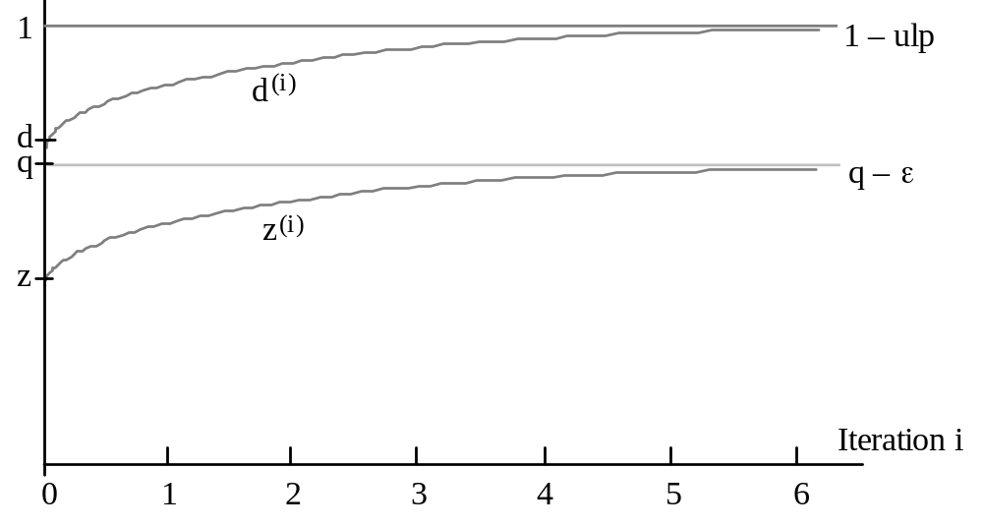
Graphical Depiction of Convergence to q
Question 3 (implementation in hardware) to be discussed later
Fig. 16.1 Graphical representation of convergence in division by repeated multiplications.
May 2020
Computer Arithmetic, Division
Slide <number>

Slide 89
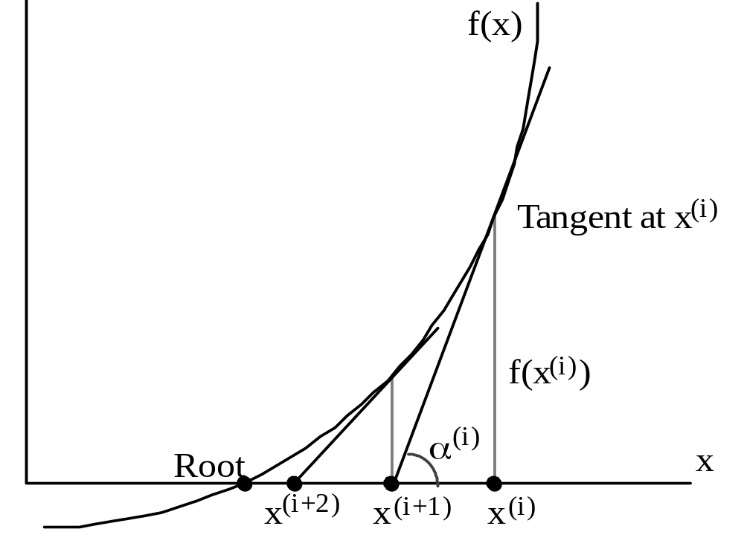
16.3 Division by Reciprocation
The Newton-Raphson method can be used for finding a root of f (x) = 0
f (x^{(i)})
tan α^{(i)} = f ′(x^{(i)}) = ––––––– x^{(i)} – x^{(i+1)}
Start with an initial estimate x⁽⁰⁾ for the root
Iteratively refine the estimate via the recurrence
x^{(i+1)} = x^{(i)} – f (x^{(i)}) / f ′(x^{(i)})
Justification:
tan α^{(i)} = f ′(x^{(i)})
= f (x^{(i)}) / (x^{(i)} – x^{(i+1)})
Fig. 16.2 Convergence to a root of
f(x) = 0 in the Newton-Raphson method.
May 2020
Computer Arithmetic, Division
Slide <number>

Slide 90
Computing 1/d by Convergence
1/d is the root of f (x) = 1/x – d
f ′(x) = –1/x²
Substitute in the Newton-Raphson
recurrence x^{(i+1)} = x^{(i)} – f (x^{(i)}) / f ′(x^{(i)}) to get:
x ^{(i+1)} = x ^{(i)} (2 − x ^{(i)}d)
One iteration = Two multiplications + One 2’s complementation
Error analysis: Let δ ^{(i)} = 1/d – x(i) be the error at the ith iteration
δ ^{(i+1)} = 1/d – x ^{(i+1)} = 1/d – x ^{(i)} (2 – x ^{(i)} d) = d (1/d – x ^{(i)})² = d (δ ^{(i)})²
Because d < 1, we have δ ^{(i+1)} < (δ ^{(i)})²
f(x)
1/d
x
−d
May 2020
Computer Arithmetic, Division
Slide <number>

Slide 91
Choosing the Initial Approximation to 1/d
With x⁽⁰⁾ in the range 0 < x⁽⁰⁾ < 2/d, convergence is guaranteed
Justification: | δ⁽⁰⁾ | = | x⁽⁰⁾ – 1/d | < 1/d
δ⁽¹⁾ = | x⁽¹⁾ – 1/d | = d (δ⁽⁰⁾)² = (d δ⁽⁰⁾) δ⁽⁰⁾ < δ⁽⁰⁾
For d in [1/2, 1):
Simple choice x⁽⁰⁾ = 1.5
Max error = 0.5 < 1/d
Better approx. x⁽⁰⁾ = 4(√3 – 1) – 2d
= 2.9282 – 2d
Max error ≅ 0.1
1/x
2
1
0
x
0
1
May 2020
Computer Arithmetic, Division
Slide <number>

Slide 92
16.4 Speedup of Convergence Division
Compute y = 1/d
Do the multiplication yz
Division can be performed via 2 ⎡log₂ k⎤ – 1 multiplications
This is not yet very impressive
64-bit numbers, 3-ns multiplier ⇒ 33-ns division
Three types of speedup are possible:
Fewer multiplications (reduce m)
Narrower multiplications (reduce the width of some x^{(i)}s)
Faster multiplications
May 2020
Computer Arithmetic, Division
Slide <number>

Slide 93
Initial Approximation via Table Lookup
Convergence is slow in the beginning: it takes 6 multiplications to get 8 bits of convergence and another 5 to go from 8 bits to 64 bits
d x⁽⁰⁾ x⁽¹⁾ x⁽²⁾ = (0.1111 1111 . . . )_{two}
Better approx
Approx to 1/d
Read this value, x⁽⁰⁺⁾, directly from a table, thereby reducing 6 multiplications to 2
A 2^{w} × w lookup table is necessary and sufficient for w bits of convergence after 2 multiplications
Example with 4-bit lookup: d = 0.1011 xxxx . . . (11/16 ≤ d < 12/16)
Inverses of the two extremes are 16/11 ≅ 1.0111 and 16/12 ≅ 1.0101
So, 1.0110 is a good estimate for 1/d
1.0110 × 0.1011 = (11/8) × (11/16) = 121/128 = 0.1111001
1.0110 × 0.1100 = (11/8) × (3/4) = 33/32 = 1.000010
May 2020
Computer Arithmetic, Division
Slide <number>

Slide 94
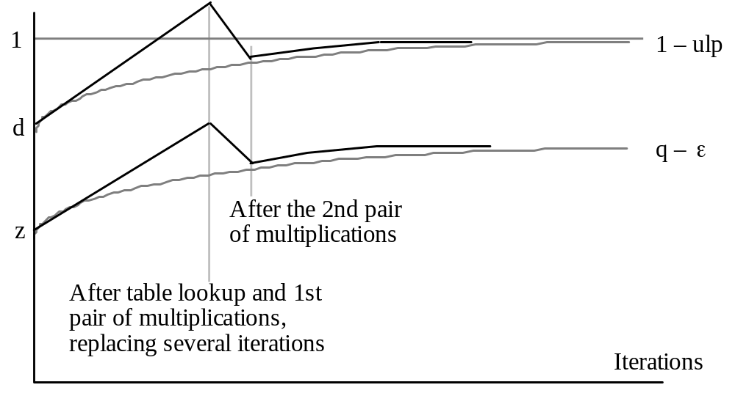
Visualizing the Convergence with Table Lookup
Fig. 16.3 Convergence in division by repeated multiplications with initial table lookup.
May 2020
Computer Arithmetic, Division
Slide <number>

Slide 95
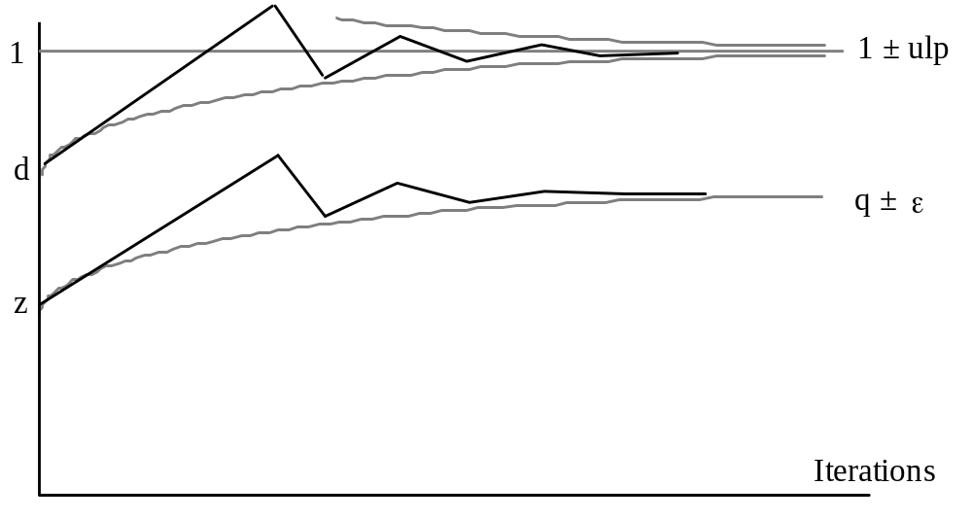
Convergence Does Not Have to Be from Below
Fig. 16.4 Convergence in division by repeated multiplications with initial table lookup and the use of truncated multiplicative factors.
May 2020
Computer Arithmetic, Division
Slide <number>

Slide 96
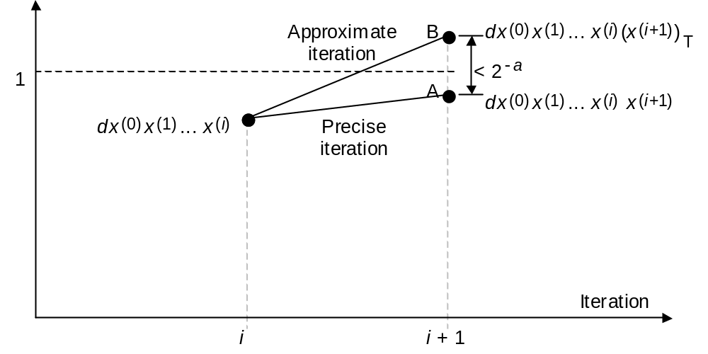
Using Truncated Multiplicative Factors
Problem 16.9a
A truncated denominator d ^{(i)}, with a identical leading bits and b extra bits (b ≤ a), leads to a new denominator d ^{(i+1)} with a + b identical leading bits
Fig. 16.4 One step in convergence division with truncated multiplicative factors.
Example (64-bit multiplication)
Initial step: Table of size 256 × 8 = 2K bits
Middle steps: Multiplication pairs, with 9-, 17-, and 33-bit multipliers
Final step: Full 64 × 64 multiplication
May 2020
Computer Arithmetic, Division
Slide <number>

Slide 97
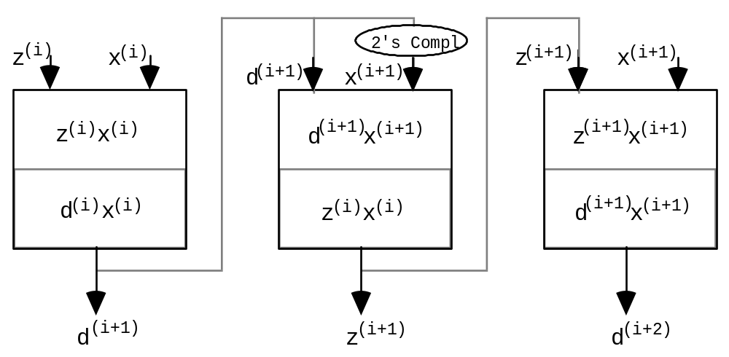
16.5 Hardware Implementation
Repeated multiplications: Each pair of ops involves the same multiplier
d ^{(i+1)} = d ^{(i)} (2 − d ^{(i)}) Set d ⁽⁰⁾ = d; iterate until d ^{(m)} ≅ 1
z ^{(i+1)} = z ^{(i)} (2 − d ^{(i)}) Set z ⁽⁰⁾ = z; obtain z/d = q ≅ z ^{(m)}
Fig. 16.6 Two multiplications fully overlapped in a 2-stage pipelined multiplier.
May 2020
Computer Arithmetic, Division
Slide <number>

Slide 98
Implementing Division with Reciprocation
Reciprocation: Multiplication pairs are data-dependent, so they cannot be pipelined or performed in parallel
x ^{(i+1)} = x ^{(i)} (2 − x ^{(i)}d)
Options for speedup via a better initial approximation
Consult a larger table
Resort to a bipartite or multipartite table (see Chapter 24)
Use table lookup, followed with interpolation
Compute the approximation via multioperand addition
Unless several multiplications by the same multiplier are needed, division by repeated multiplications is more efficient
However, given a fast method for reciprocation (see Section 24.6), using a reciprocation unit with a standard multiplier is often preferred
May 2020
Computer Arithmetic, Division
Slide <number>

Slide 99
16.6 Analysis of Lookup Table Size
Table 16.2 Sample entries in the lookup table replacing the first four multiplications in division by repeated multiplications
–––––––––––––––––––––––––––––––––––––––––––––––––––––––
Address d = 0.1 xxxx xxxx x ⁽⁰⁺⁾ = 1. xxxx xxxx
–––––––––––––––––––––––––––––––––––––––––––––––––––––––
55 0011 0111 1010 0101
64 0100 0000 1001 1001
–––––––––––––––––––––––––––––––––––––––––––––––––––––––
Example: Table entry at address 55 (311/512 ≤ d < 312/512)
For 8 bits of convergence, the table entry f must satisfy
(311/512)(1 + . f) ≥ 1 – 2^{–8} (312/512)(1 + . f) ≤ 1 + 2^{–8}
199/311 ≤ .f ≤ 101/156
163.81 ≤ f = 256 × . f ≤ 165.74
Two choices: 164 = (1010 0100)_{two} or 165 = (1010 0101)_{two}
May 2020
Computer Arithmetic, Division
Slide <number>

Slide 100
A General Result for Table Size
Theorem 16.1: To get w ≥ 5 bits of convergence after the first iteration of division by repeated multiplications, w bits of d (beyond the mandatory 1) must be inspected. The factor x⁽⁰⁺⁾ read out from table is of the form (1.xxx . . . xxx)_{two}, with w bits after the radix point
Proof strategy for sufficiency: Represent the table entry 1.f as the integer v = 2^{w} × .f and derive upper / lower bound expressions for it. Then, show that at least one integer exists between v_{lb} and v_{ub}
Proof strategy for necessity: Show that derived conditions cannot be met if the table is of size 2^{k–1} (no matter how wide) or if it is of width k – 1 (no matter how large)
Excluded cases, w < 5: Practically uninteresting (allow smaller table)
General radix r : Same analysis method, and results, apply
May 2020
Computer Arithmetic, Division
Slide <number>

